Slide 1
TERMS OF WAR
15 Words to Know

Slide 2
#1: Revolution
A Forcible overthrow of a government or social order in favor of a new system.
Synonyms : Rebellion, revolt insurrection, uprising, riot, coup

Slide 3
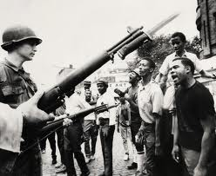

Slide 4
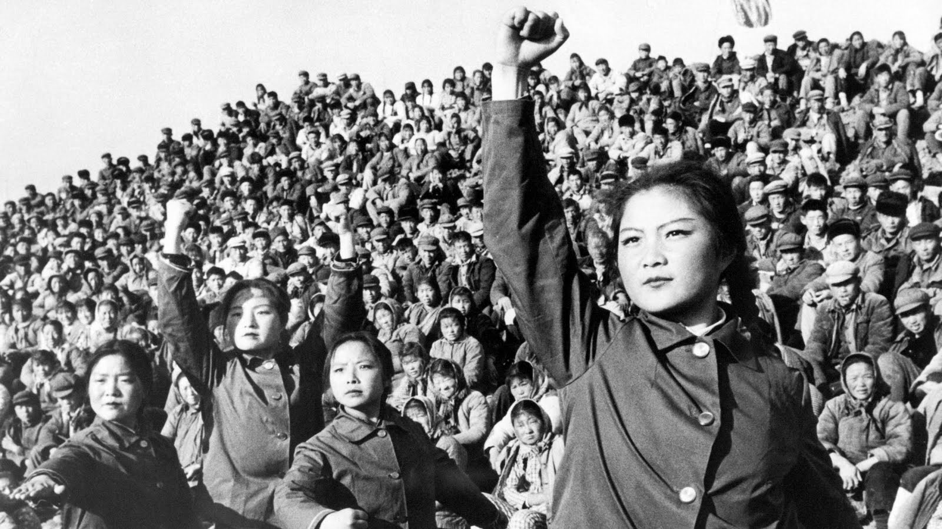

Slide 5
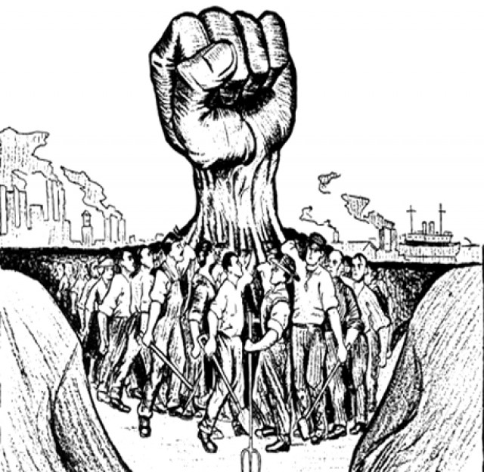

Slide 6
#2: Coup d'état
When a small group of people from the existing government secretly plans to violently overthrow the current government

Slide 8
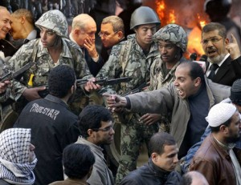
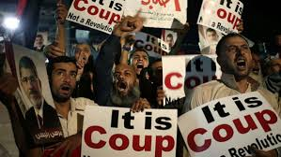

Slide 9
#3: Tyranny
A government in which all power belongs to one person, and there is cruel and unfair treatment of everyone without authority.
Synonyms: Absolute power, dictatorship

Slide 10
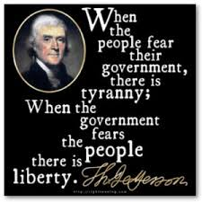
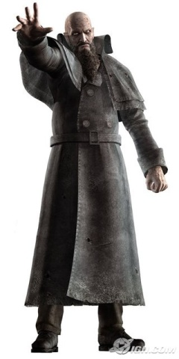

Slide 11
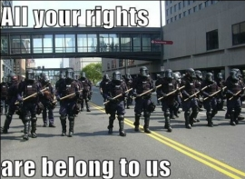

Slide 12
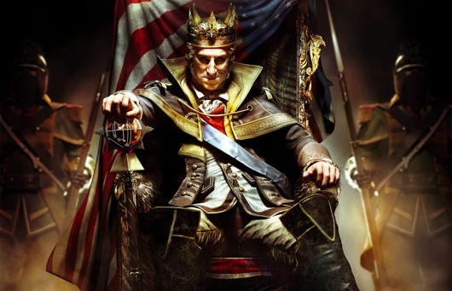

Slide 13
#4: Oppression
The Use of authority or power in a cruel or unjust manner.

Slide 14
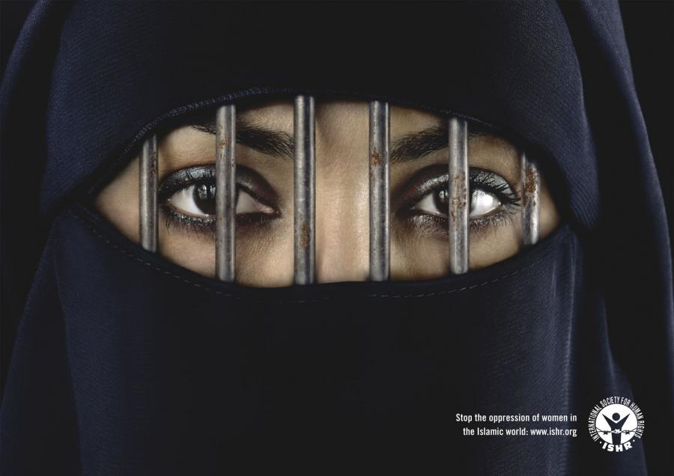

Slide 15
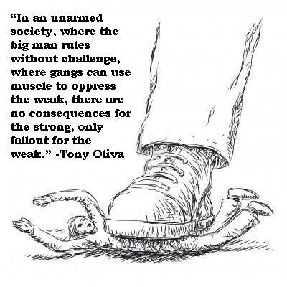
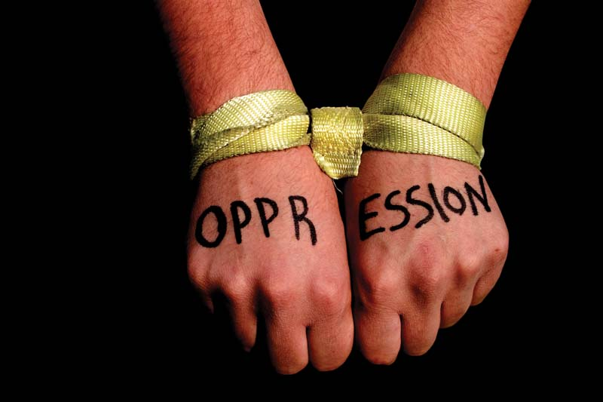
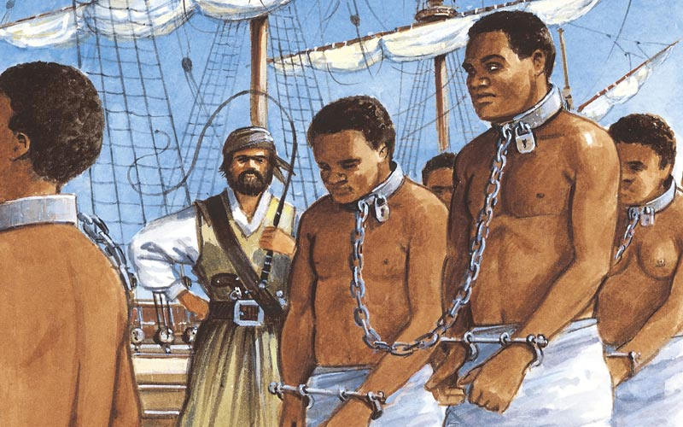

Slide 16
#5: Massacre
A violent killing of a large number of people

Slide 17
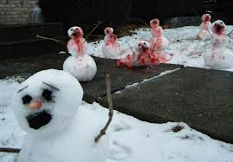

Slide 18
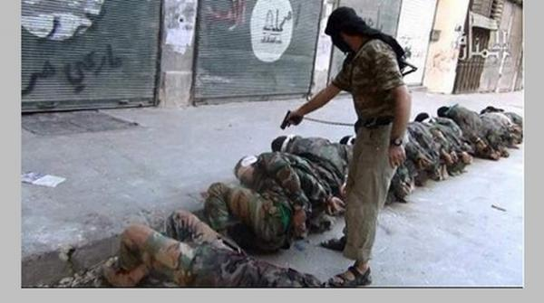
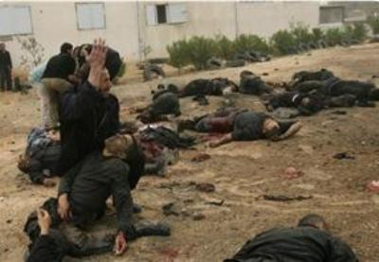

Slide 19
#6: Political Prisoner
Someone who is put in for his or her participation in political activities

Slide 20
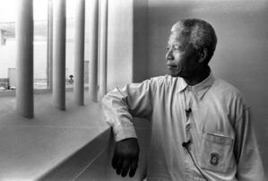

Slide 22
#7: Refugee
A person who flees their home (or country) To escape times of war and political oppression because of their race, religion, or culture

Slide 23
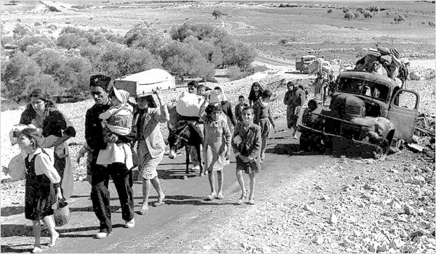

Slide 24
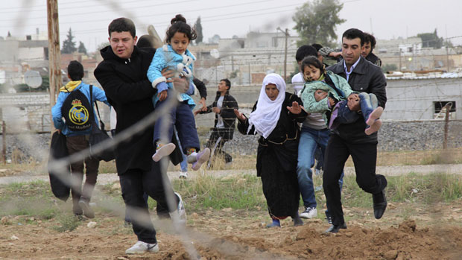

Slide 25
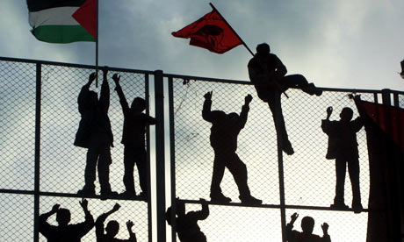

Slide 26
#8: Martyr
A person who Dies fulfilling a religious commandment or dies fighting/defending their faith, family, or country.
Note: Another word for Islamic Martyr is Shahid or Shaheed.

Slide 27
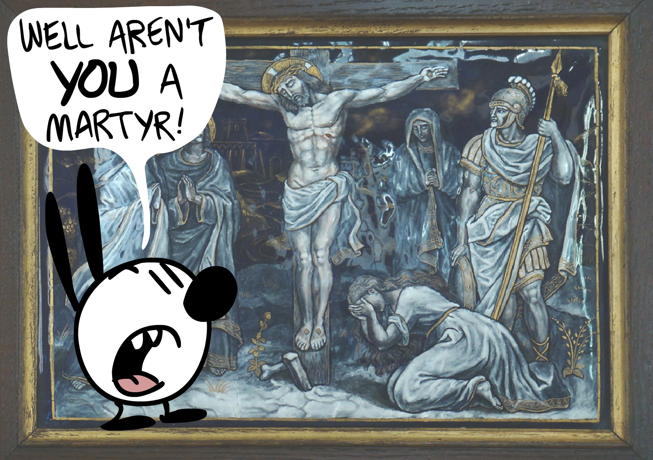

Slide 28
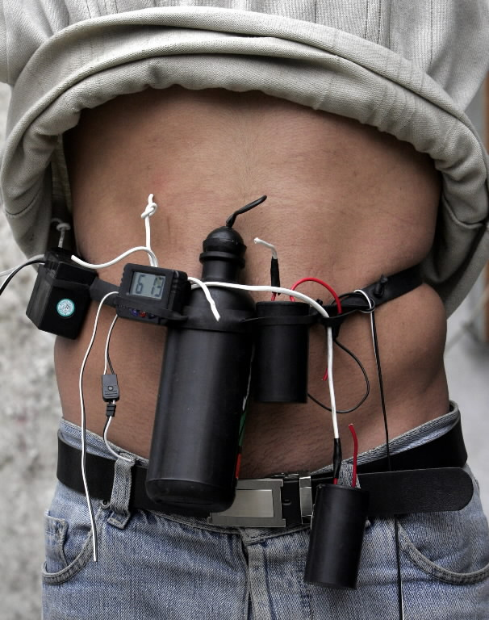

Slide 29
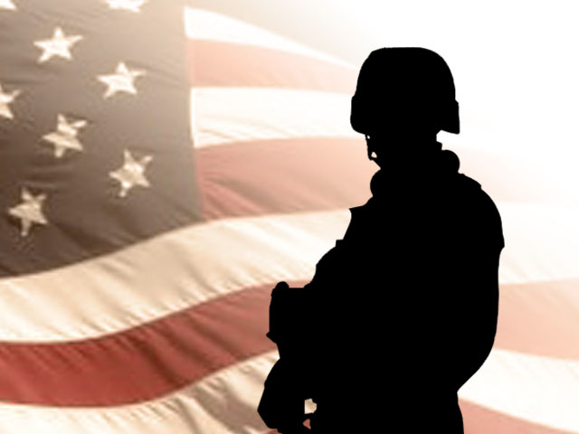

Slide 30
#9: Civilian
A person who is not an active member of the military or police or firefighting force. (Normal people who live normal lives)

Slide 32
#10: Rebel
A person who refuses to resist or follow rules from the government or ruler

Slide 33
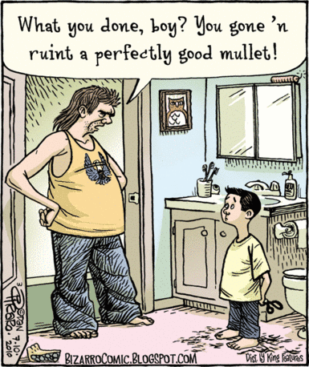

Slide 34
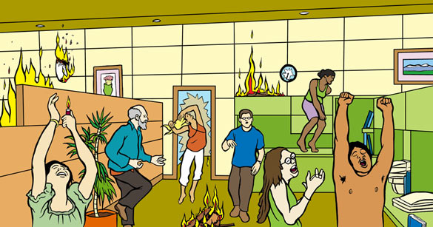

Slide 35
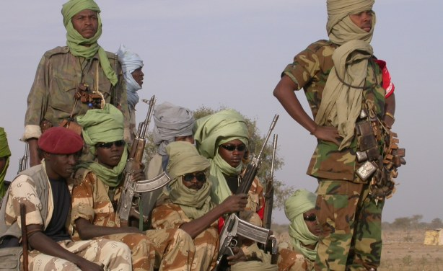

Slide 36
#11: Victim
A person injured or killed as a result of a crime or accident

Slide 37
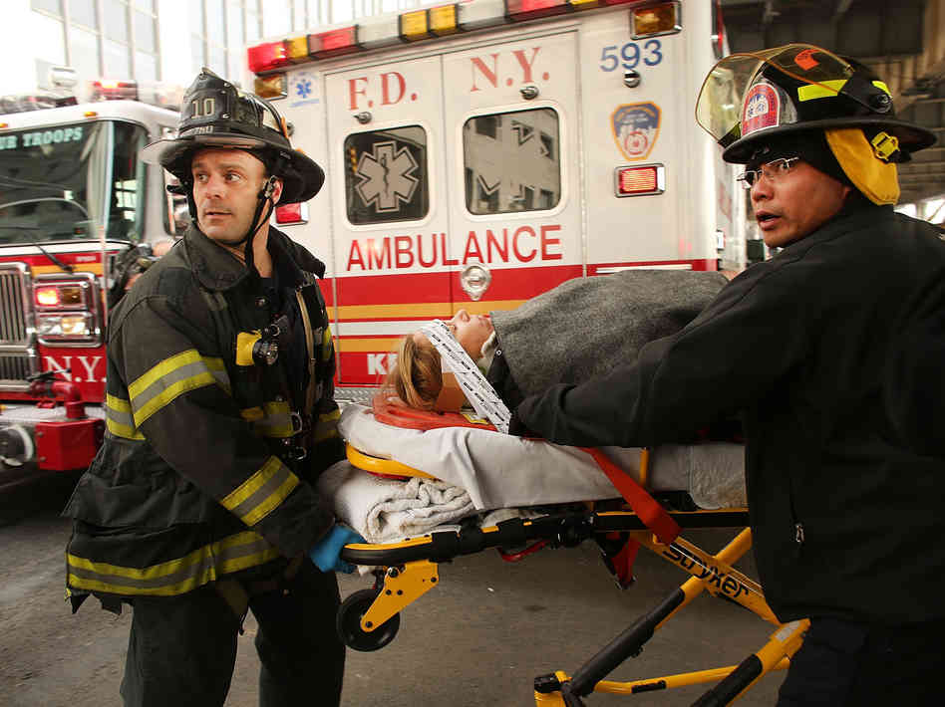

Slide 38
#12: Bystander
A person who is present at an event
but does not participate

Slide 39
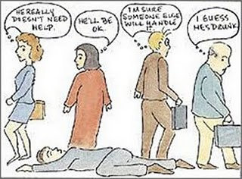

Slide 40
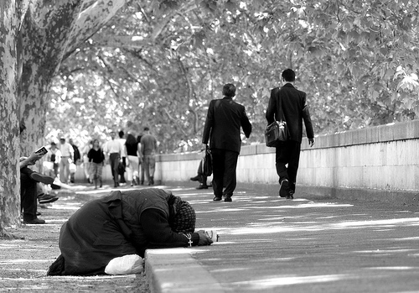

Slide 41
#13: Displaced
When a person is forced to leave his/her home but remains within the boarders of his/her own country
Note: This can be due to a natural disaster or war

Slide 42
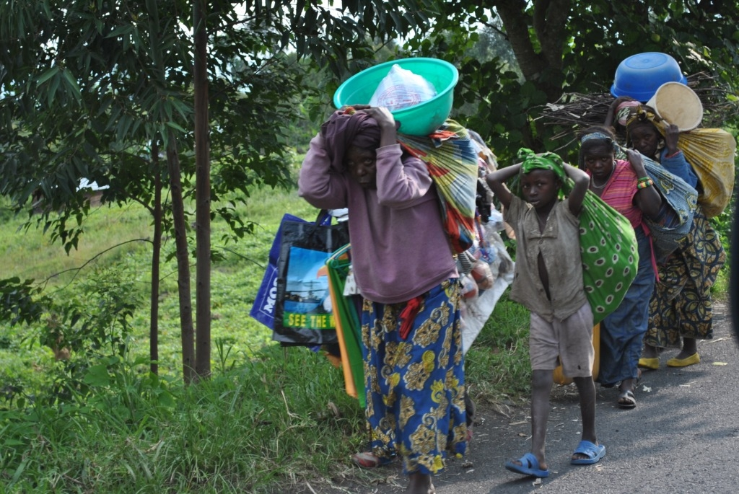

Slide 43
#14: Militant
a willingness to use strong, extreme, and forceful methods to achieve something

Slide 44
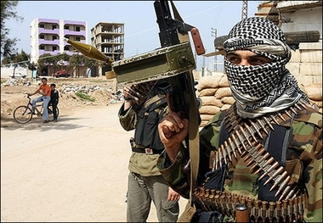

Slide 45
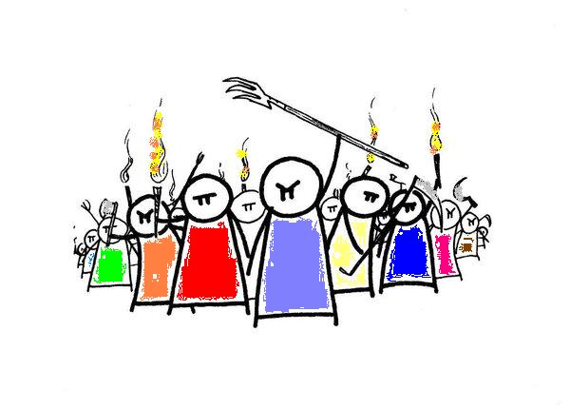

Slide 46
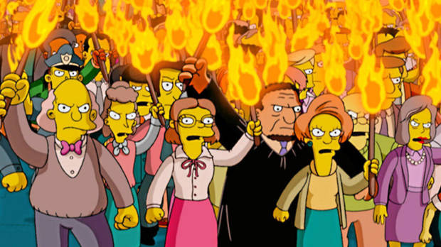

Slide 47
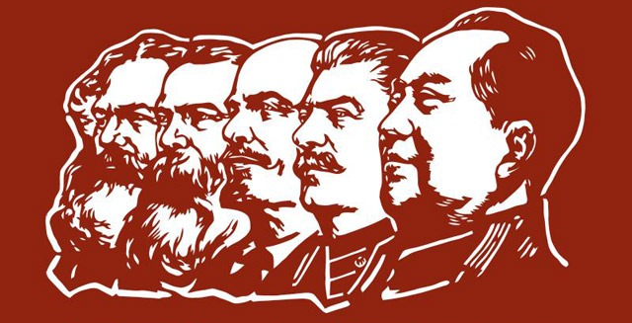
#15: War is not always the choice of the people.

Slide 48
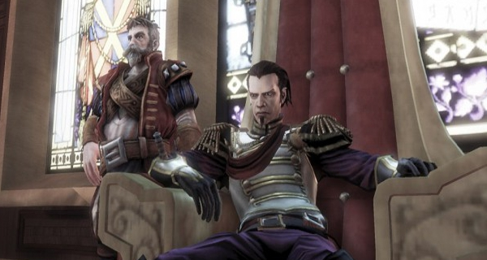

Slide 49
