Slide 1
Announcements
DO NOW
Log in to EdModo
Take the 02.18.2014 Entrance Ticket Quiz
(You have 6 minutes and 7 questions. Go!)
24 Days until the STAAR
Writing Tracker has been updated
Report Card Grade Posted
Revist Test Grade From Yesterday

Slide 2
Sample Essay Critique
The objective for today is for you to fully understand the STAAR rubric and be able to apply the expectations to your own writing.

Slide 3
What kind of writing do the STAAR graders want to see?
In general they are looking for an essay that demonstrates a clear and logical thought process. They want to see:
Clear thesis statements
Organized paragraphs {hook + thesis, body paragraphs, conclusion} YOU MUST INDENT
Specific examples that prove your thesis
A complete answer to the prompt

Slide 4
STAAR Expository Rubric
The rubric contains three sections:
Organization of Ideas:
Writers ability to construct an organized essay
Introduction
Main Ideas
Conclusion
2. Development of Ideas:
Writers ability to construct a logical and complete thought and provide sufficient support {main ideas and specific examples}
3. Language:
Writers ability to construct varying and grammatically correct sentences and to use appropriate diction.

Slide 5
STAAR Expository Rubric
 | Score Point 1 LIMITED (D-F) | Score Point 2 BASIC (C) | Score Point 3 SATISFACTORY (B) | Score Point 4 ACCOMPLISHED (A)
Organization Of Ideas | No structure (unorganized) No or unclear thesis Difficult to follow – does not stay on topic | Student tries to have structure (paragraphs) but they are not organized well Thesis is there but weak Student repeats ideas and/or goes off topic | Clear and meaningful paragraphs Good, clear thesis 90% focused with logical transitions between paragraphs | Clear, meaningful and very strong paragraphs Thesis is strong and thoughtful
Development Of Ideas | Ideas are weak and not specific, and show the writer does not fully understand topic. | Specific examples are given but only partially explained, too short, and not thoughtful. | Specific examples are appropriate and somewhat meaningful and proves the student knows and understands the prompt | Specific examples are clear and well-chosen. Specific examples show the writer connects the prompt to unique experiences that make the reader think.
Language | Simple, low-level word choice Sentences are awkward So many grammar mistakes that it makes the essay hard to understand and/or confusing. | Simple word choice Some sentences are awkward Some grammar mistakes that make parts of the essay confusing | Good word choice Grammar is good (but not perfect) | Word choice is purposeful and precise. Grammar is good with few errors.

Slide 6
Phase 1
You will have 15 minutes to do the following
Read each essay.
Fill out the rubric.
Assign a score for each.
*The purpose is for you to quickly assign a score, you will do a more in depth read later.

Slide 7
Phase 2
In Depth Critique: As a Group
Each table gets an essay: A, B, C, D
Fill out 4 pros and 4 cons of each essay.
Correct grammar.
Determine a final score.
IMPROVEMENTS
Sticky 1: 1 specific way to improve ORGANIZATION
Sticky 2: 1 specific way to improve DEVELOPMENT OF IDEAS
Sticky 3: 1 specific way to improve LANGUAGE
***Complete sentences***

Slide 8
Share Out
Each group will share how they scored their essays and why. You are to provide specific evidence for your scores.

Slide 9
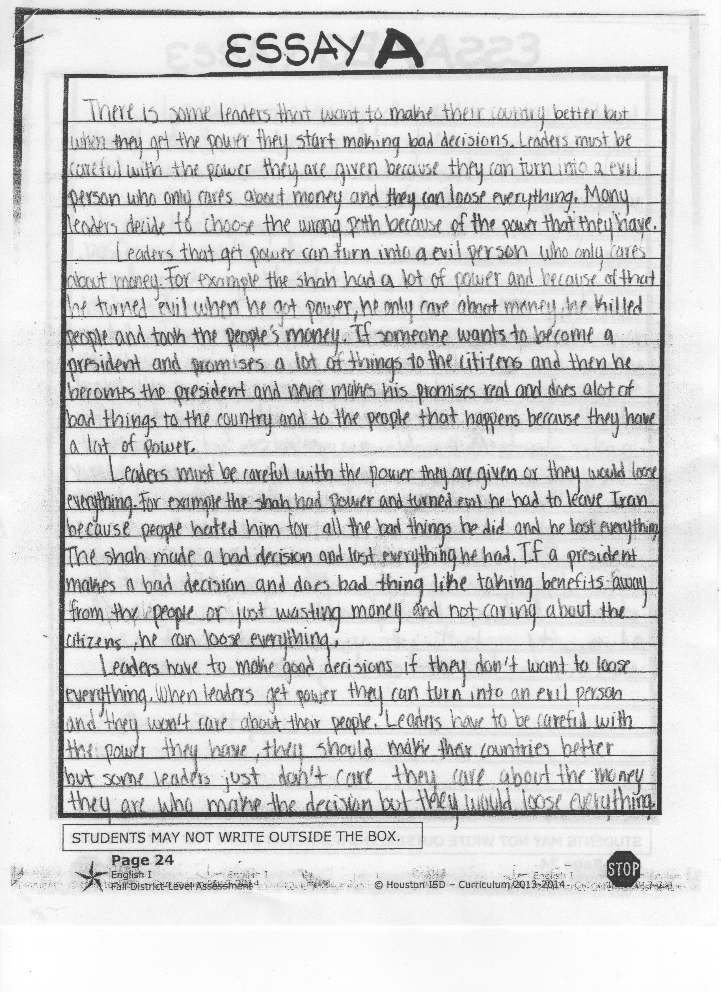
Reveal Essay A
3

Slide 10
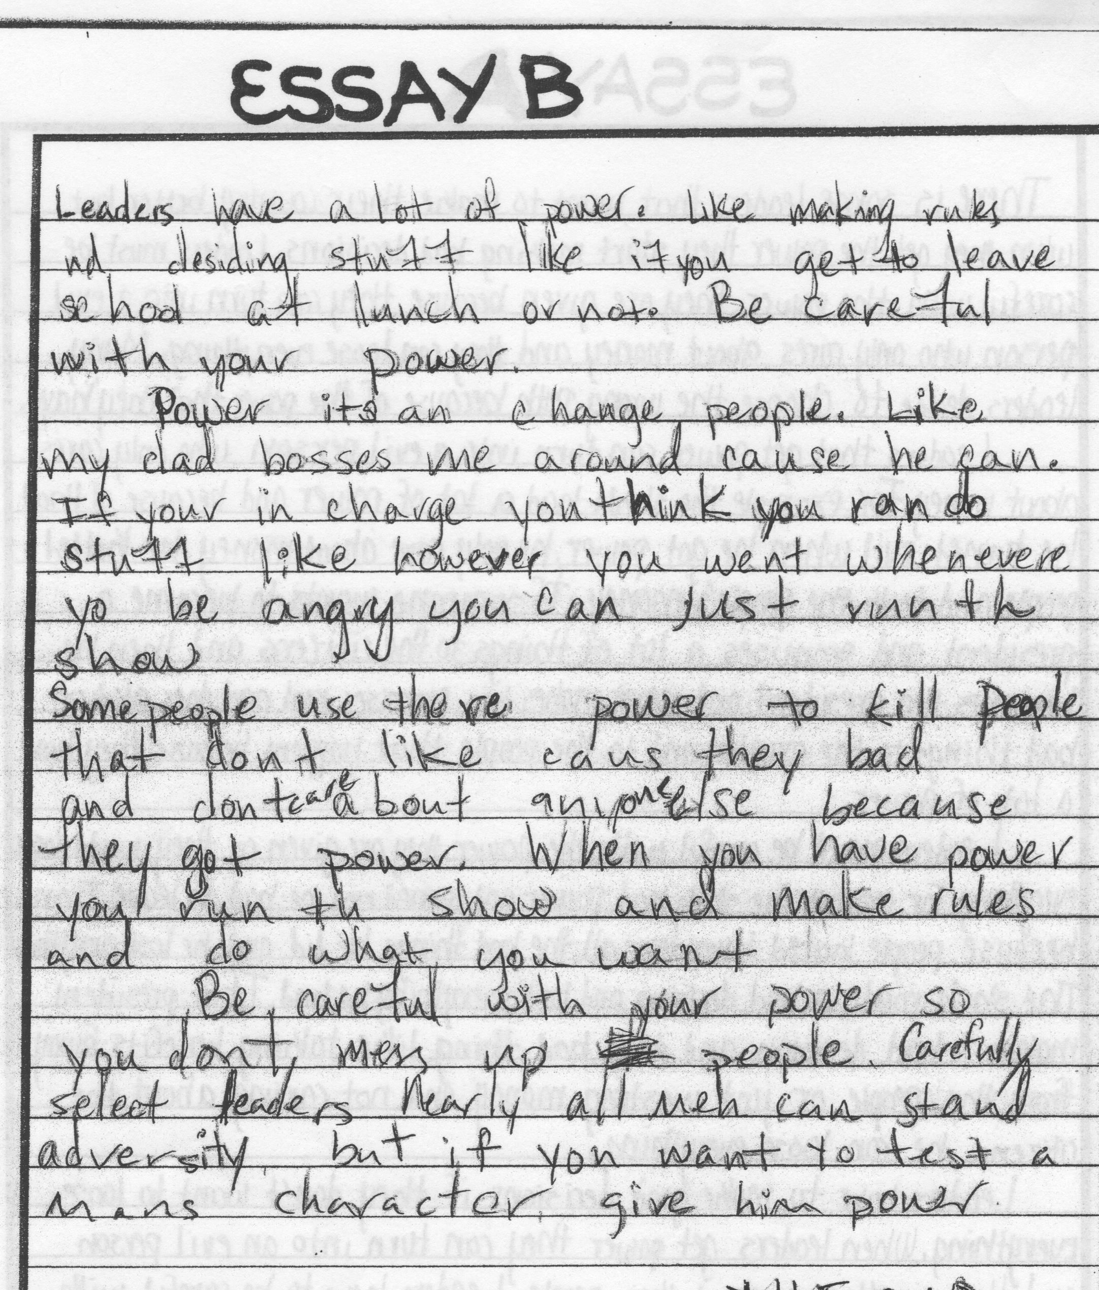
Reveal Essay B
1

Slide 11
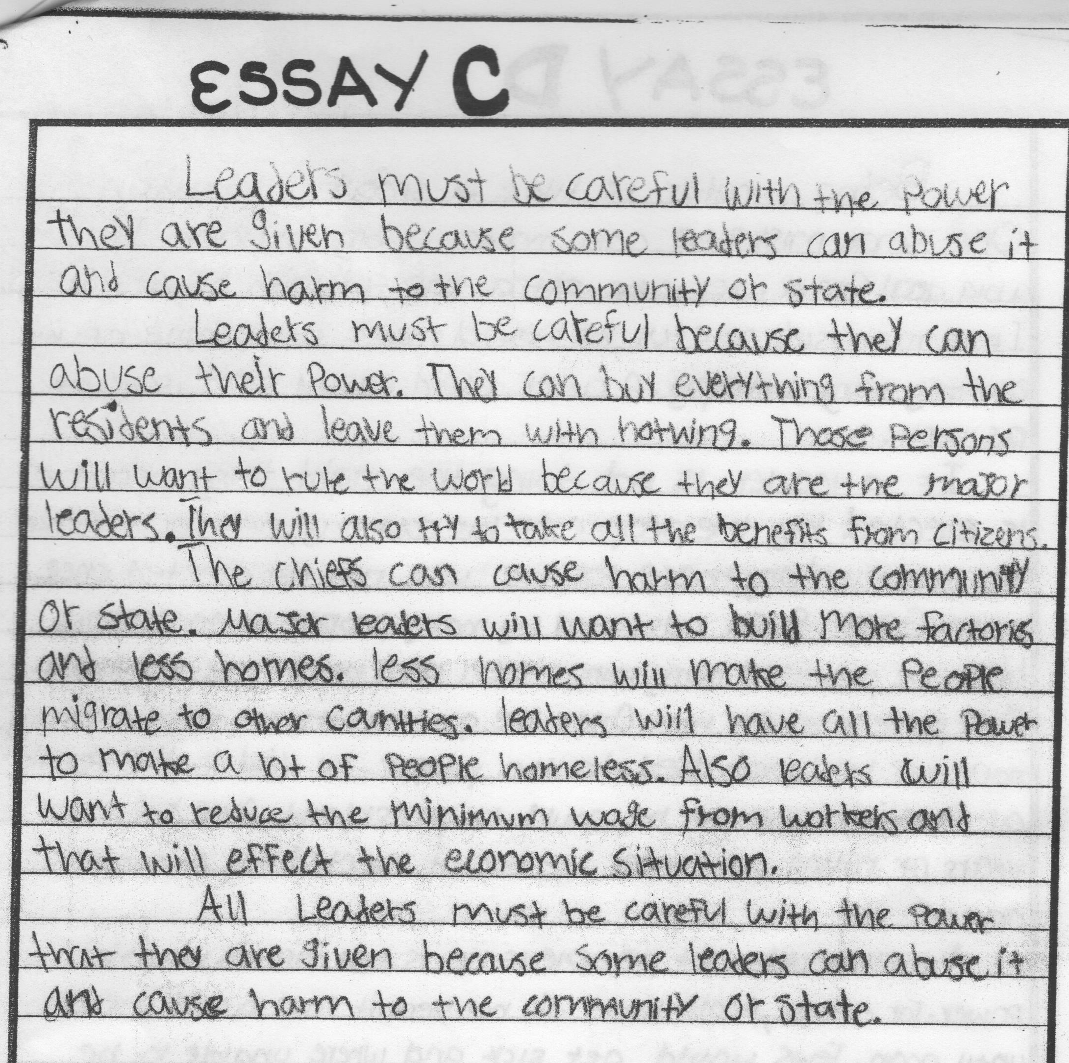
Reveal Essay C
2

Slide 12
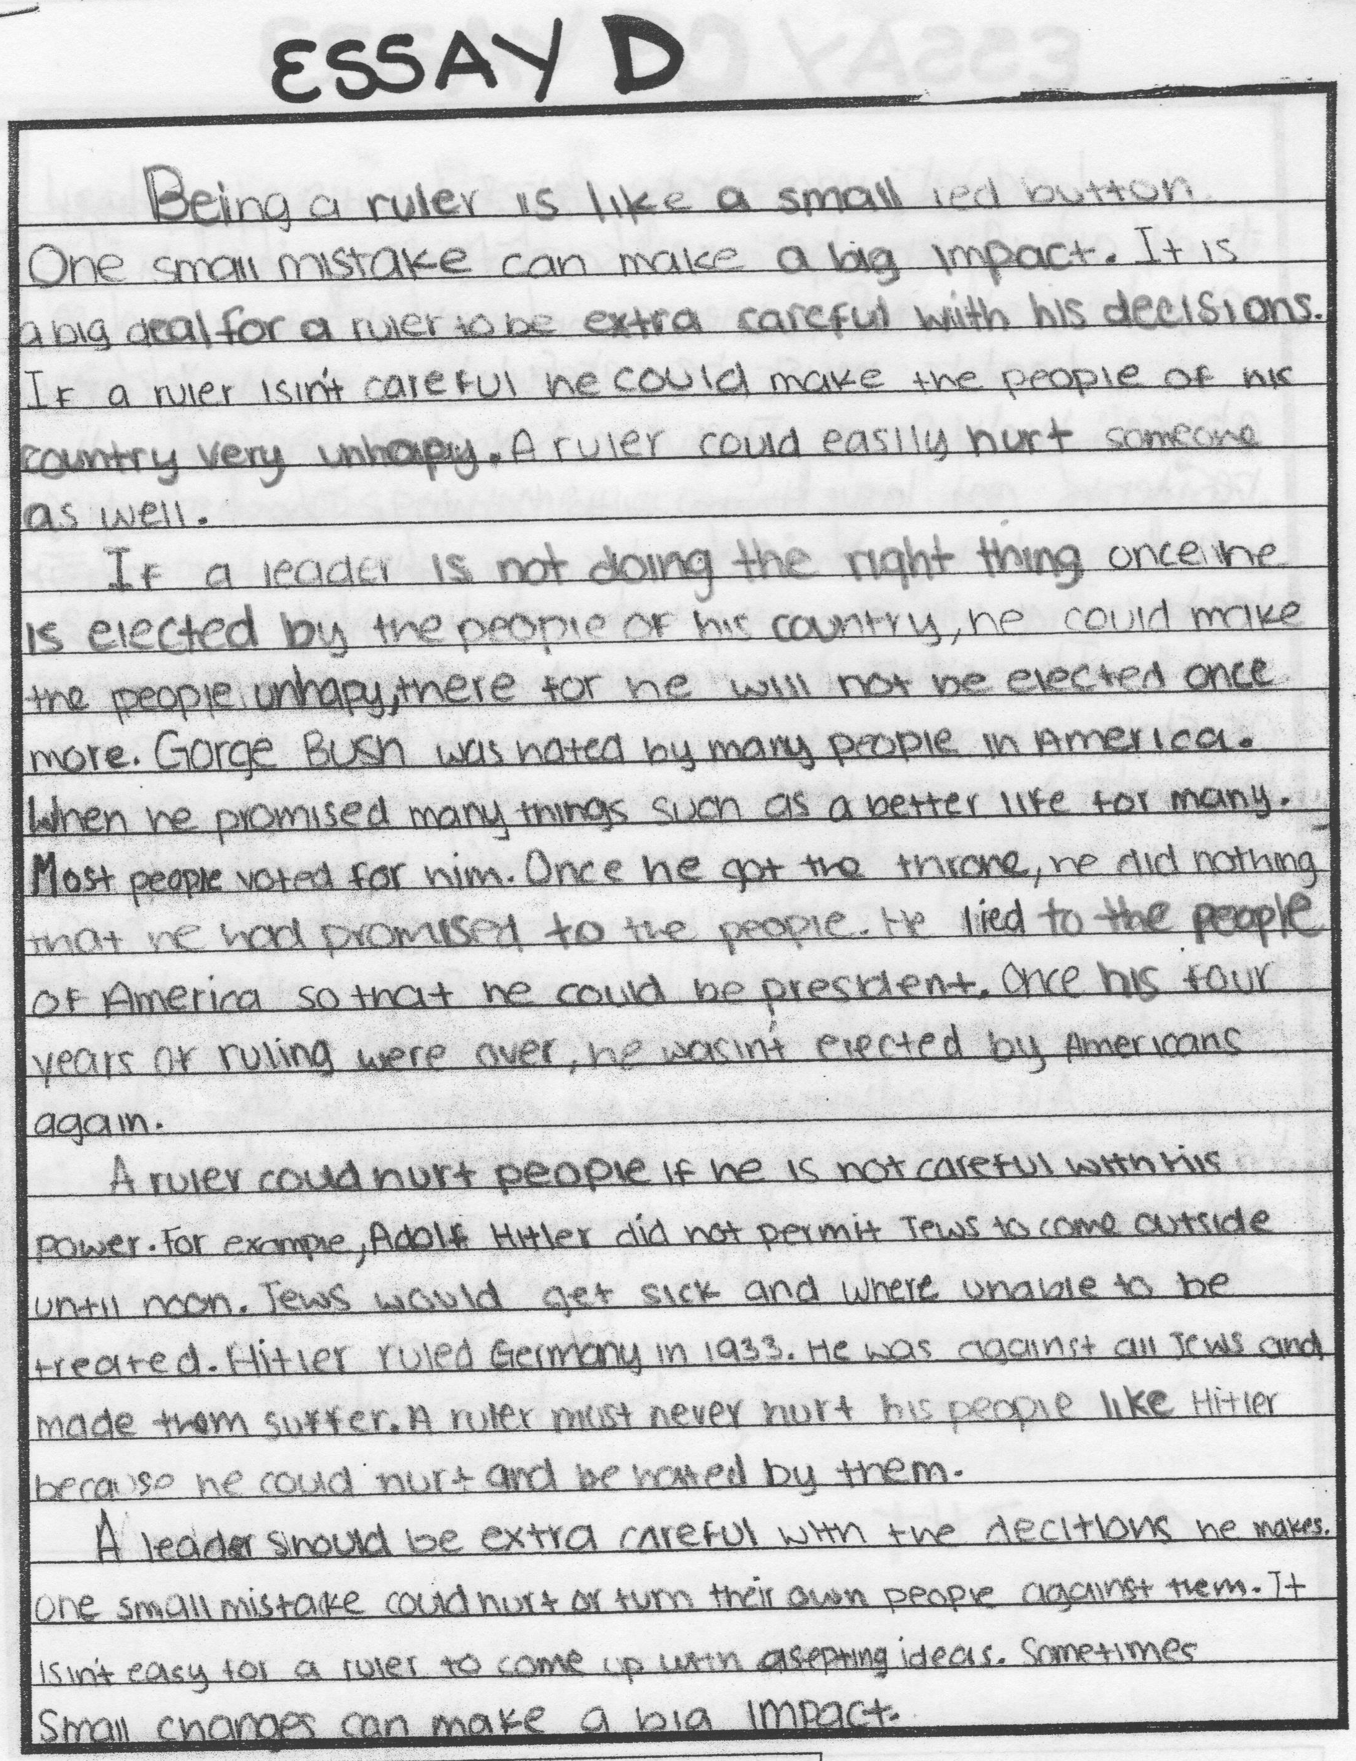
Reveal Essay D
4

Slide 13
Exit Ticket
Write one paragraph explaining what you need to do to improve your score. Be specific!
Use direct quotes from rubric.
4 positive things (to improve)
4 negative things (to improve)
Explain how you will raise your score on the next essay,
Submit your response on Edmodo. (The assignment is title 02.18.14 Exit Ticket)
This is your first grade of the
new 6 weeks!

