Slide 1
Announcements
1. Making up assignments: There are many of you who did not complete the assessment. You will be doing so during class; any classwork you miss will be your responsibility to complete.
2. Extra Credit: The extra credit posted on the weebly site is acceptable. However, remember the vocabulary is potentially worth 50 points towards your lowest grade in the gradebook. The other assignments are worth at most 10 points each.
3. Tutorials: Tuesday Tutorials will resume this Tuesday.

Slide 2
Cross Genre Ace
Create a Word document
Save it as “Cross Genre Ace” in your English I folder which should be in SkyDrive
At the top label your document “Cross Genre Ace Notes”
You will only type the words that have been highlighted in blue.
At the end you will submit your document on Edmodo. Your document should have notes and three questions answered in complete sentences following the ACE strategy.
This will count as a quiz grade.

Slide 3
Painting/Photo Thematic Connection
Entitle the first section of your notes as {1. Painting Photo Thematic Connection}
When you are analyzing a photo or painting in order to make a comparison to a piece of literature or text you must follow the steps bellow.
List all the details (Great or small) In order to recognize the theme of a painting you must first absorb all of the details. The tiniest detail may be significant or even most important.
Ask the following connections.
Are there any relationships between the figures or characters in the painting?
Is there any character or image that seems to take center stage? Or be of more importance than the others?
Are the various colors or lack there of seem to be significant?

Slide 4
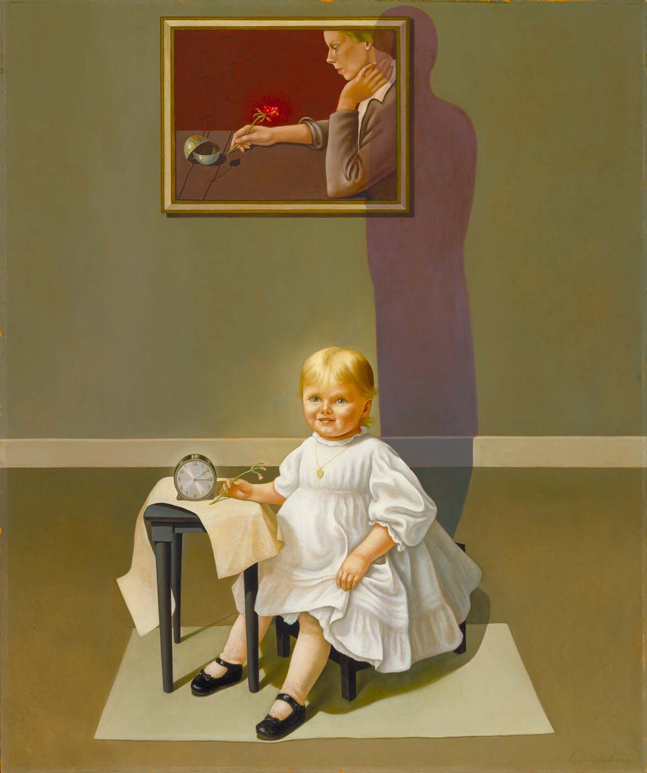
Details
Answer the questions that follow.
Are there any relationships between the figures or characters in the painting?
Is there any character or image that seems to take center stage? Or be of more importance than the others?
Are the various colors or lack there of seem to be significant?

Slide 5
1. What thematic connection can you make between the painting and Persepolis? (What do they have in common)

Slide 6
Poetry Thematic Connections
Entitle this section of notes {2. Poetry Thematic Connections}
Much like analyzing a painting poetry requires you to follow a process.
Break down each stanza or line by summarizing each in the margins. Once you have summarized the poem you will be better able to see the individual pieces.
Ask yourself the following questions.
Is there a transition or shift in mood?
Is there a change in subject matter between the stanzas?
Does the author come to any realizations or conclusions through the poem?
Does the author seem to be speaking directly to the reader?

Slide 7
Nature’s first green is gold, Her hardest hue to hold. Her early leaf’s a flower; But only so an hour. Then leaf subsides to leaf. So Eden sank to grief, So dawn goes down to day. Nothing gold can stay.
Summarize each line in the space below.
Ask yourself the following questions.
Is there a transition or shift in mood?
Is there a change in subject matter between the stanzas or lines?
Does the author come to any realizations or conclusions through the poem?
Does the author seem to be speaking directly to the reader?

Slide 8
Nature’s first green is gold, Her hardest hue to hold. Her early leaf’s a flower; But only so an hour. Then leaf subsides to leaf. So Eden sank to grief, So dawn goes down to day. Nothing gold can stay.
2. What thematic connection can you make between the painting and Persepolis? (What do they have in common)

Slide 9
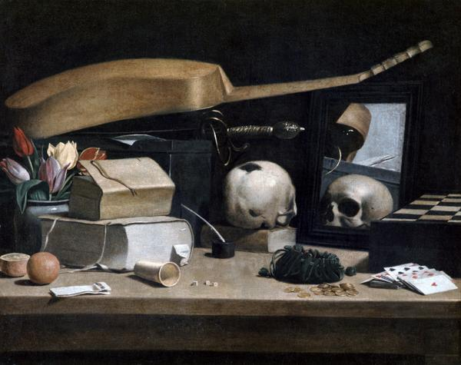
Two roads diverged in a yellow wood,
And sorry I could not travel both
And be one traveler, long I stood
And looked down one as far as I could
To where it bent in the undergrowth;
Then took the other, as just as fair,
And having perhaps the better claim, Because it was grassy and wanted wear; Though as for that the passing there
Had worn them really about the same,
And both that morning equally lay
In leaves no step had trodden black.
Oh, I kept the first for another day!
Yet knowing how way leads on to way,
I doubted if I should ever come back.
I shall be telling this with a sigh
Somewhere ages and ages hence:
Two roads diverged in a wood, and I–
I took the one less traveled by,
And that has made all the difference.
3. Both the artist and the writer, whose work you see above, had a clear theme in mind when they completed their pieces. What connection can you make between the two?
Be sure to follow the steps we discussed for each before composing your answer. You may walk up and look more closely at the photo. This should take approximately 10 minutes.
*When you finish your answer submit your document to the assignment posted on Edmodo.

