Slide 1
The Holy Grail…….
Your new best friend
Setting up “the English Holy Grail”

Slide 2
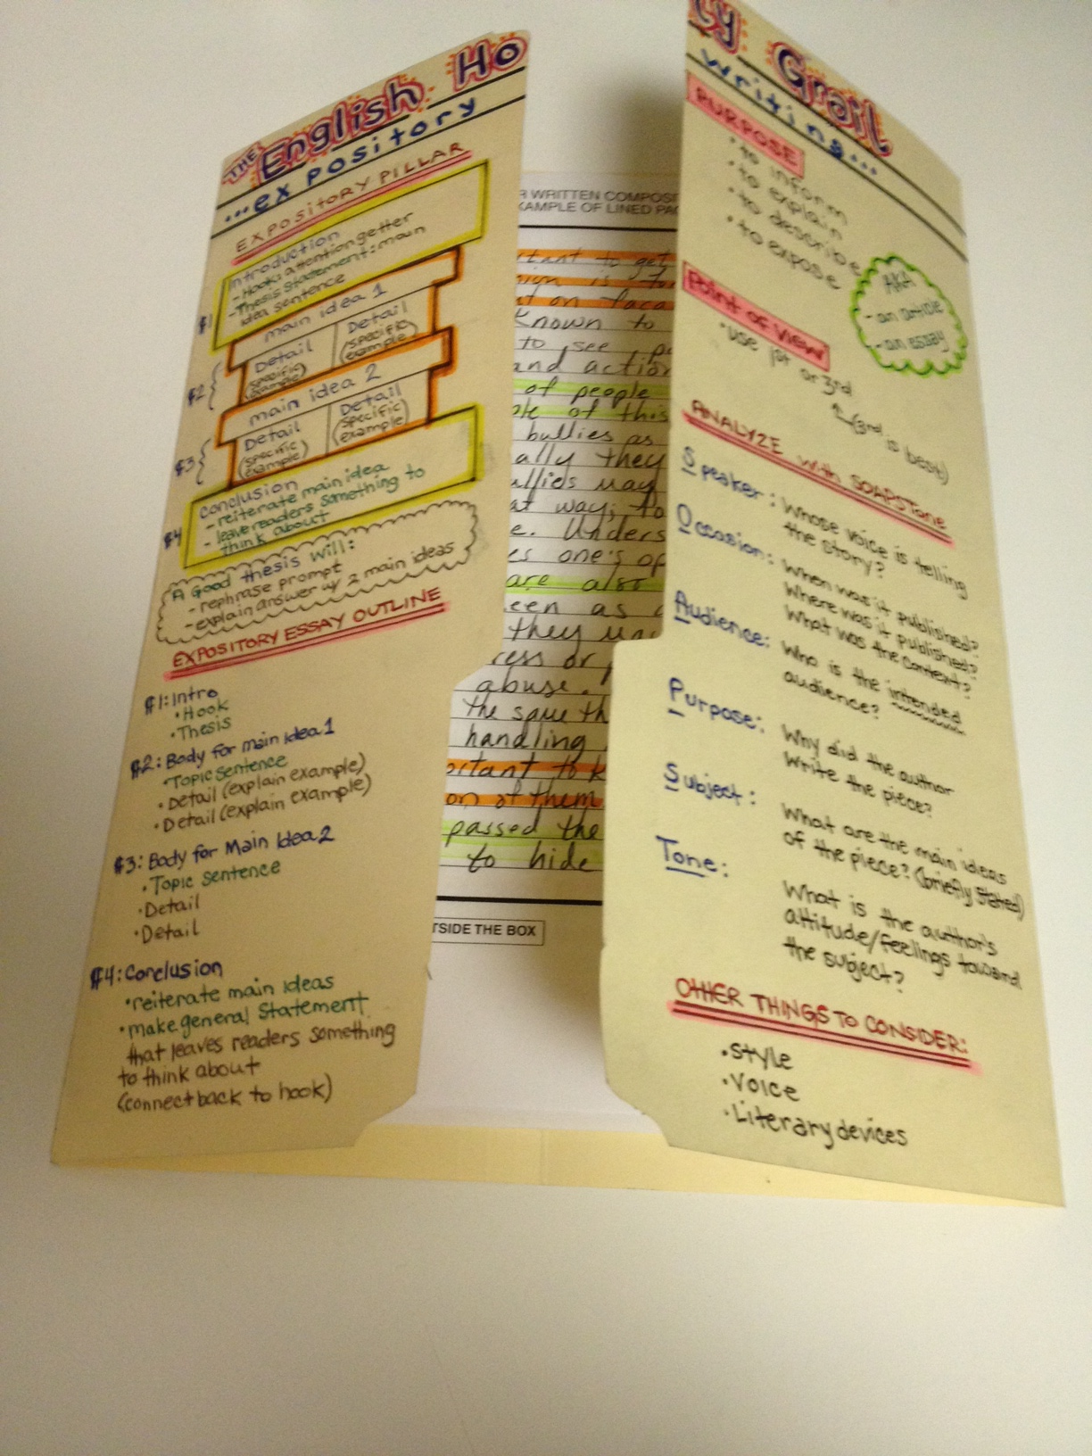
SET Up directions
Spread the folder out flat.
Fold the 2 flaps of the folder
so they meet in the middle.

Slide 3
FRONT

Slide 4
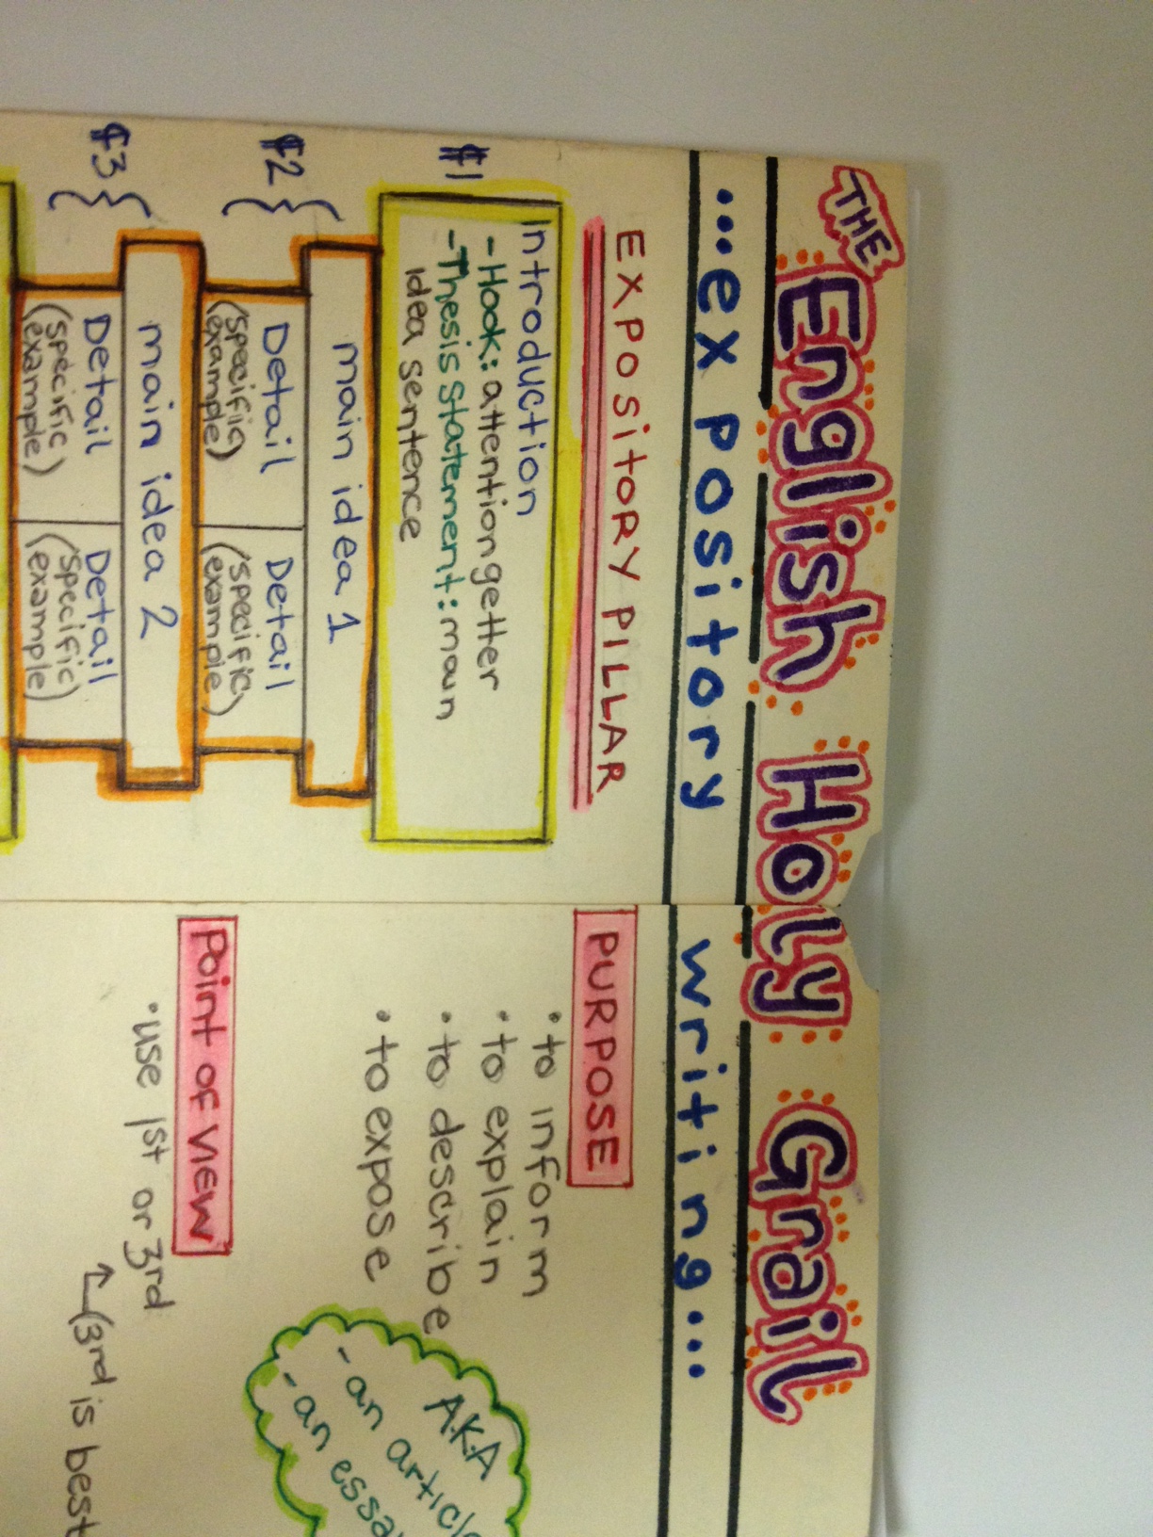
Front

Slide 5
Front Left Panel

Slide 6
Front Left Panel

Slide 7
Front left panel
Paragraph 1: Intro
Hook
Thesis
Paragraph 2: Body for Main Idea 1
Topic Sentence
Detail (explain example)
Detail (explain example)
Paragraph 3: Body for Main Idea 2
Topic Sentence
Detail
Detail
Paragraph 4: Conclusion

Slide 8
Front Right panel

Slide 9
Front right panel

Slide 10
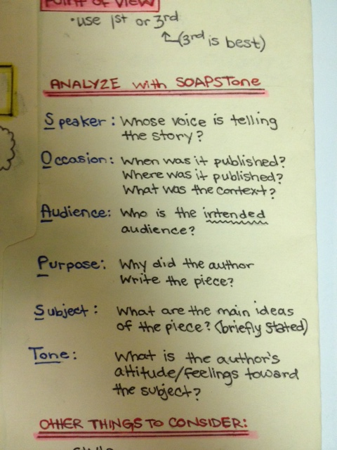
Front right panel

Slide 11
Front Right panel

Slide 12
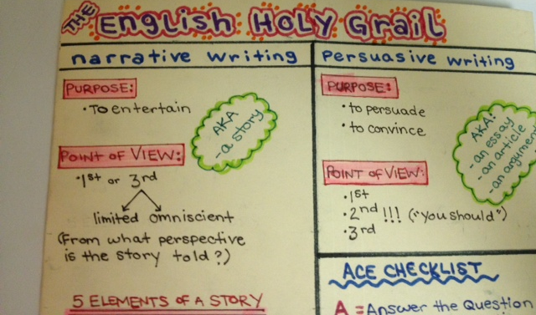
Back – top half

Slide 13
Back – Left side

Slide 14
Back – left side

Slide 15
Back – left side

Slide 16
Back – left side

Slide 17
Back – left side

Slide 18
Back – left side

Slide 19
Back – Right side

Slide 20
Back – Right side

Slide 21
Back – Right side

Slide 22
Staple your annotated essays in the inside-center:
Top
Expository
Narrative
Persuasive
Resource Page
Bottom

Slide 23
Inside – left panel

Slide 24
Inside – right panel
A lot
Lots
Good
Happy
Bad
Sad
Said
Fun
Scared
Pretty
Funny
Very
Mess/Messy

Slide 25
Inside – right panel (bottom half)
Strong Words
A lot:: many, numerous, innumerable, often, frequent, abundant
Fun: pleasurable, amusing, enjoyable, jolly, entertaining, pleasant, engaging
Scared: startled, fearful, terrified, frightened, petrified
Pretty: attractive, appealing, beautiful, gorgeous, stunning
Very: extremely, exceedingly, incredibly, intensely, severely
Said:

