Slide 1
1st Period Announcements
Scoreboard is back! Help me!
Edmodo Comments on Project + Projects on Site
Paper Passback Frenzy End of Period
15 minutes: 9:34am – Remind Me to Stop
Report Cards = Wednesday
3rd 6-Weeks Grades Posted Later this Week

Slide 2
Point of view review Workshop

Slide 3
Points of View: Pronoun signal words
1st Person
I, me, my, we, us, ours
2nd Person
you, your
3rd Person
he, she her, they, them

Slide 4
Points of View: Pronoun signal words
“I am in the room.”
1 = 1st person
“You come in the room.”
You = 2nd person
“He (or she) came in the room”
He/she = 3rd person

Slide 5
Points of View: Signal words and use
1st Person
I, me, my, we, us, ours
Narrator is in the story
Example
I went home. Tim came over. I couldn't play.

Slide 6
Points of View: Signal words and use
2nd Person
you, your
Used when giving instructions or persuading.
Examples
First, gather your materials. Add 1 cup sugar to flour.
You shouldn’t judge people based on their looks.

Slide 7
Points of View: Signal words and use
3rd Person
he, she her, they, them
Narrator is not involved in the story.
Omniscent
(narrator knows thoughts and feelings of multiple characters)
Example
Tim was mad at Shay. He blamed her. Shay knew Tim would be mad, but she wanted to live her life.

Slide 8
Points of View: Signal words and use
3rd Person
he, she her, they, them
Narrator is not involved in the story.
Limited
(tells thoughts & feelings of one character)
Example
Tim was mad at Shay. He blamed her. Shay just left without saying anything. She left a note and then left him.

Slide 9
Dialogue and narration
Dialogue = when characters speak.
Narration = when the narrator speaks.
“Quotation marks” separate narration from dialogue.
Example
“Help” my cousin Jack said.

Slide 10
Identifying point of view
It's about the narrator (who tells the story)
We're not looking at dialogue.
We don't care what characters say.
Only the narrator's voice matters.

Slide 11
1) What is the point of view?
Sideways Stories from Wayside School by Louis Sachar
Leslie sat in front of Paul. She had two long, brown pigtails that reached all the way down to her waist. Paul saw those pigtails, and a terrible urge came over him. He wanted to pull a pigtail. He wanted to wrap his fist around it, feel the hair between his fingers, and just yank. He thought it would be fun to tie the pigtails together, or better yet, tie them to her chair. But most of all, he just wanted to pull one.
What is the point of view? How do you know?
3rd Person - Limited
If it is third-person, which character’s thoughts are revealed?
Paul

Slide 12
2) What is the point of view?
Invitation to the Game by Monica Hughes
And we scrounged. Next to survival, scrounge was probably the most important word in our new vocabulary. We found a store that was throwing out water-damaged mattresses. Getting them home was a problem, since we had to make two trips, leaving Brad and Katie, armed with sticks to guard over those that remained. I truly expected them to be challenged by some gang boss, but they said that the only person who came by was a scrawny little rat of a girl living alone. We let her have one of the mattresses.
What is the point of view? How do you know?
First Person

Slide 13
3) What is the point of view?
How to Grill by Steven Raichlen
Once you have your grill assembled, the next thing to decide is where to put it. A grill puts out a lot of heat, so you should position it several feet away from the side of the house or any plants or shrubbery. You’ll have an easier time with a spot that is sheltered from the wind. When positioning a grill on a wooden deck, remember that sparks and live embers can fall from a charcoal grill.
What is the point of view? How do you know?
2ND Person

Slide 14
4) What is the point of view?
Some dark night Shelly said, “I hate squirrels,” but really she loved them. Carol said, “They smell,” but really, she loved them too. Both of them thought that squirrels were pretty cute.
What is the point of view? How do you know?
3rd person – omniscient
If it is third-person, which character’s thoughts are revealed?
Both – Shelly and Carol

Slide 15
5) What is the point of view?
We were walking through the halls from English to Geography. We passed a group of kids chatting loudly. One student held a stack of books eight miles high. As Jeremy and I passed by, the known school clown leapt from the hall and slammed the stack of books to the floor. "That idiot!” screeched Jeremy, and I was startled by his outburst.
What is the point of view? How do you know?
1st Person

Slide 16
6) What is the point of view?
“Pssst. Psssst. Hey Marco,” whispered the girl in the third row. Well, whisper may not be the best choice of words because I could hear her four rows back. I hate it when people talk during movies, so all you movie-whispers need to stop. When people talk during the movies, it takes away the entire movie watching experience. Rather than being absorbed into the story on screen, I am forced back to reality when annoying teens talk during the movies. So I urge all of you to embrace the slogan “silence is golden” and, for goodness sakes, stop talking in the theater.
What is the point of view? How do you know?
2nd Person

Slide 17
Points of View & genres
Expository
First
Narrative
First
Persuasive
Second
Third
Third

Slide 18
You Do: Using Point of view!
Using 1st person point of view, write a paragraph (5 sentences) about betrayal.
Using 2nd person point of view, write a paragraph (5 sentences) about betrayal.
Using 3rd person point of view, write a paragraph (5 sentences) about betrayal.

Slide 19
You should be able to:
Purposefully choose an effective point of view when your write.
Write in the appropriate point of view based on the specified genre (narrative, persuasive, expository).
Identify point of view in other people’s writing.

Slide 20
The Holy Grail…….
Your new best friend

Slide 21
SET Up Expectations
Follow along and don’t get behind
Finished quality! Be neat and organized!
Don’t go ahead!
Treat this like your baby!!! Don’t fold or wrinkle!

Slide 22
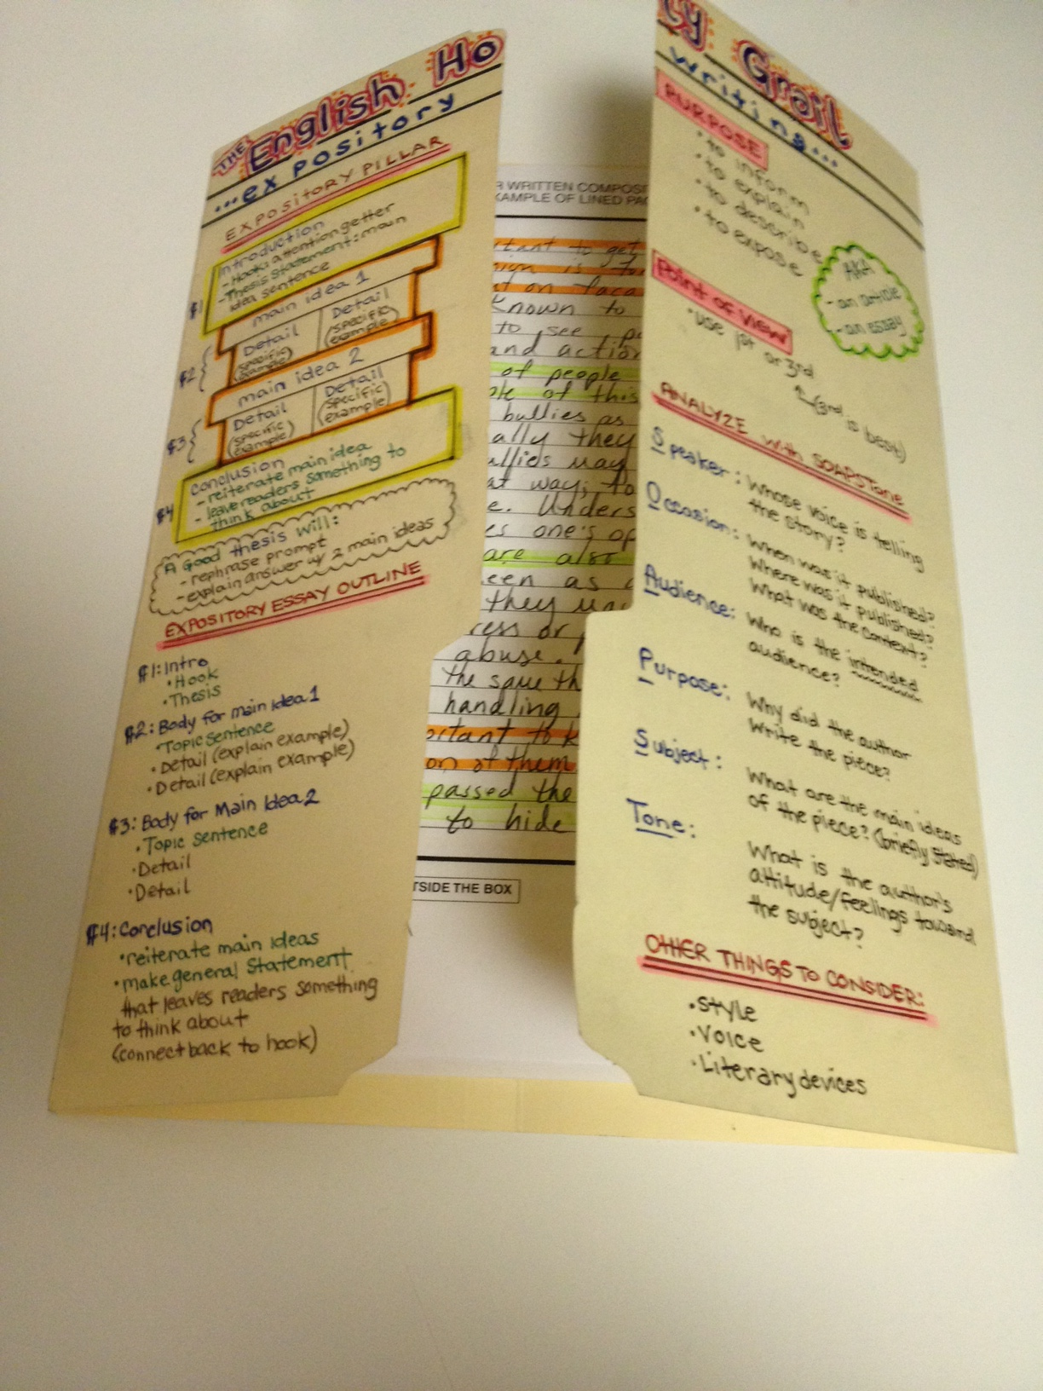
SET Up directions
Spread the folder out flat.
Fold the 2 flaps of the folder
so they meet in the middle.

Slide 23
SET Up directions
At the top put the title “The English Holy Grail”
It shouldn’t take up too much space.

Slide 24
SET Up directions
Choose a color for all your main headings
Under the main title write “Expository Writing”

Slide 25
SET Up directions
Flip to the back and add the “English Holy Grail” heading to the back.

Slide 26
SET Up directions
Add the “narrative writing” and “persuasive writing” headings to the top, and draw a line diving the back in half vertically.

Slide 27
Analyzing 2 Essays
THINK-PAIR-SHARE
Read through both essays (6 minutes)
Think about the difference between the 2 essays
With your table talk about the differences and similarities between the 2 essays (3 minutes)
Share Out

Slide 28
Expository

Slide 29
Persuasive

