Slide 1
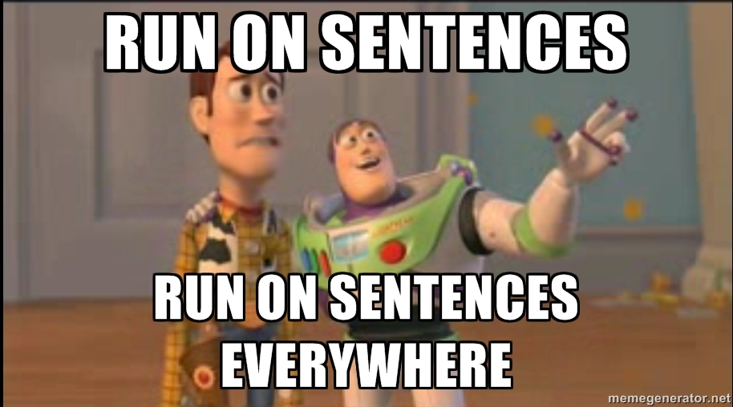
Run-On Sentences Workshop

Slide 2
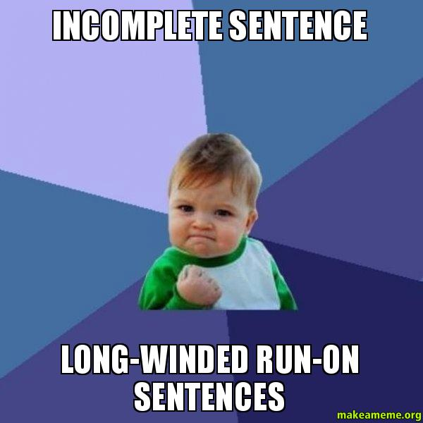
When do they happen?
Run-on sentences occur when independent clauses are not joined properly.
There are two types of run-on sentence:
the fused sentence
the comma splice.

Slide 3
Types of Run Ons
The dishes need to be done get going on it right away.
What are the two independent clauses?
Fused Sentence
The Problem? No punctuation or conjunction (FANBOYS) between the two clauses

Slide 4
Types of Run Ons
The dishes need to be done, get going on it right away.
What are the two independent clauses?
Comma Splice
The Problem? 2 independent clauses are joined with a comma but no conjunction.

Slide 5
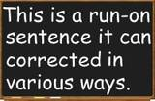
Types of Run On Fixes
The dishes need to be done get going on it right away.
1. Comma + Conjunction (FANBOYS)
The dishes need to be done, so get going on it right away.

Slide 6
Types of Run On Fixes
The dishes need to be done get going on it right away.
2. Semicolon
The dishes need to be done; get going on it right away.

Slide 7
Types of Run On Fixes
The dishes need to be done get going on it right away.
3. 2 Separate Sentences
The dishes need to be done. Get going on it right away.

Slide 8
Types of Run On Fixes
The dishes need to be done get going on it right away.
4. Dependent Clause + Independent Clause
Since the dishes need to be done, get going on it right away.

Slide 9
Let’s Fix It Together
Basketball is the best sport because it’s an active game, the players never stop running.
Problem: comma splice or fused sentence
Fix: Comma + Conjunction (FANBOY)
Basketball is the best sport because it’s an active game, and the players never stop running.

Slide 10
Let’s Fix It Together
Sharpstown High School is the best school in Houston all the teachers are amazing.
Problem: comma splice or fused sentence
Fix: semicolon
Sharpstown High School is the best school in Houston;
all the teachers are amazing.

Slide 11
Let’s Fix It Together
Halloween is my favorite holiday it’s the one time a year that I can be anything I want to be.
Problem: comma splice or fused sentence
Fix: your choice
Halloween is my favorite holiday. It’s the one time a year that I can be anything I want to be

Slide 12
You Do It!
Corrections: # 2
Fix: your choice
#1-10
Identify the problem.
(Is it a comma splice or fused sentence)
Correct the sentence using the method specified.

Slide 13
Check Your Work
1. My mother, father and sister are coming to dinner tonight, it’s going to be a fun reunion.
Problem: comma splice or fused sentence
1. My mother, father and sister are coming to dinner tonight, and it’s going to be a fun reunion.

Slide 14
Check Your Work
2. I like learning English it makes me tired.
Problem: comma splice or fused sentence
2. I like learning English, but it makes me tired.

Slide 15
Check Your Work
3. My sister was taller than me when we were young, now I am the tallest it is fun.
Problem: comma splice or fused sentence
3. My sister was taller than me when we were young. Now I am the tallest it is fun.

Slide 16
Check Your Work
4. I love school, I love learning, my teacher is nice.
Problem: comma splice or fused sentence
4. I love school, I love learning, and my teacher is nice.

Slide 17
Formatting Your Essay
Due on Tuesday!!!
11/5/13
MUST Be Typed
12 Point, Times New Roman Font
Name, Period, Date on Top
Joe Awesome
1st & 2nd Period
October 31, 2013
Expository Essay: Stepping Back from the Ledge
This is my really awesome first paragraph. It starts with an attention getting hook.

Slide 18
7th Pd……..Observer Tomorrow

Slide 19
Peer Editing Practice
We where all over my aunts house when my dog Riley was running around like crazy. He was chasing me around in circles. all of a suden I look and riley he was in the pool! swimming in my aunts pool. I couldn’t believe my eyes that the dog was in the pool. I dashed to the pool and jumpd in and swan over to Riley and pulled him to the steps. He got out and shook all over us like a sprinkler on a hot day. I was glad riley was o.k. and that I saved him.
1 compliment
2 suggestions

Slide 20
Peer Editing
Trade papers with someone at your table.
Read their paper once through without stopping.
Use the checklist to make notes, improvements, and suggestions.

