Slide 1
Symbolism

Slide 2
Symbolism Overview: https://www.youtube.com/watch?v=9-F599mU6L4 Symbolism Recap with Aladdin: https://www.youtube.com/watch?v=-mjkj36hY-4
Symbolism Clips

Slide 3
- a thing that represents something else - usually something physical that represents something more abstract
Recap: What is a symbol?

Slide 4
Symbols can be visual or embedded text. - visual: lamp in the movie Aladdin - embedded in text: flowers in a novel Authors use symbolism to represent a theme in a few words.
More about symbols…

Slide 5
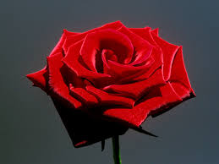
Author’s Use
An author will use the symbol in place of extraneous or unnecessary words.
For example the color red has been used to symbolize passion, love, anger, hate, and danger depending on the object that is painted red.

Slide 6
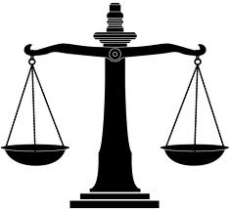
We see symbols all day everyday, BUT these symbols only have significance to those who know the background information.
For example, what is the symbolism of the image below?

Slide 7
Or this symbol?

Slide 8
One more…..

Slide 9
A look at a few more symbols: https://www.youtube.com/watch?v=bXJUq4kdGAE
Symbolism Clips

Slide 10
Symbolism Across Genres

Slide 11
We Wear the Mask By Paul Laurence Dunbar (1872-1906)
We wear the mask that grins and lies,
It hides our cheeks and shades our eyes,
This debt we pay to human guile;
With torn and bleeding hearts we smile,
And mouth with myriad subtleties.
Why should the world be over-wise,
In counting all our tears and signs?
Nay, let them only see us, while
We wear the mask.
Vocab!
Rephrase!
We wear the mask that grins and lies,
It hides our cheeks and shades our eyes,
This debt we pay to human guile;
With torn and bleeding hearts we smile,
And mouth with myriad subtleties.
Why should the world be over-wise,
In counting all our tears and signs?
Nay, let them only see us, while
We wear the mask.

Slide 12
We Wear the Mask By Paul Laurence Dunbar (1872-1906)
Vocab!
Rephrase!
We wear the mask that grins and lies,
It hides our cheeks and shades our eyes,
This debt we pay to human guile;
With torn and bleeding hearts we smile,
And mouth with myriad subtleties.
Why should the world be over-wise,
In counting all our tears and signs?
Nay, let them only see us, while
We wear the mask.

Slide 13
Connection Questions
Questions by Table: Discuss & Share Out
What is the significance of the author’s pairing of ‘grins and lies’ in the first line? (**hint**hint: connotation)
Why would one hide their cheeks and eyes?
What is the purpose of a mask?
What does a mask symbolize?
All Write
5. Describe a time where you have worn a mask.

