Slide 1
Terms of war

Slide 2
Revolution
A Forcible overthrow of a government or social order in favor of a new system.
Synonyms: Rebellion, revolt, insurrection, uprising.

Slide 3
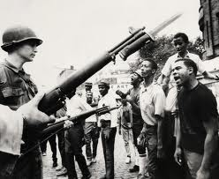

Slide 4
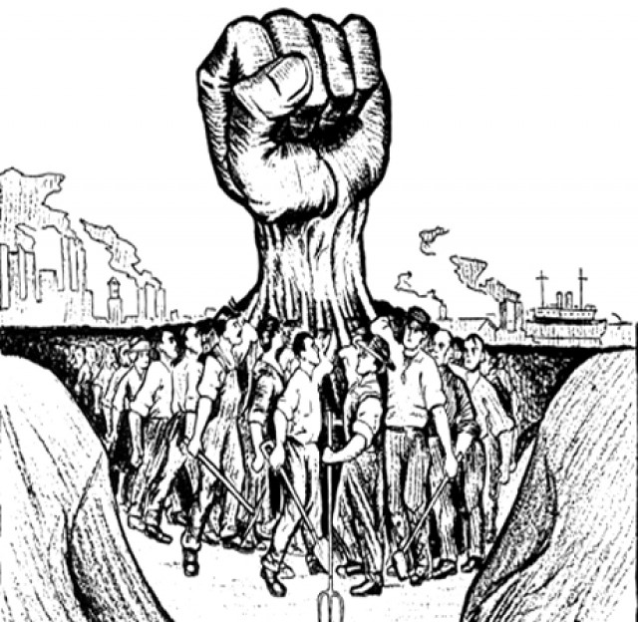

Slide 5
Coup d'état
A sudden attempt by a small group of people from the existing government to quietly plan to overthrow the current government usually through a violent act.
Phrase was coined in France 1646.

Slide 7
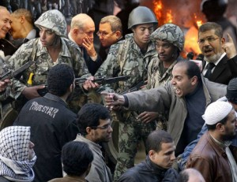
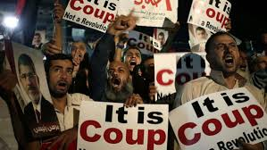

Slide 8
Tyranny
A government in which all power belongs to one person: cruel and unfair treatment to everyone that does not have authority.
Synonyms: Absolute power, dictatorship

Slide 9
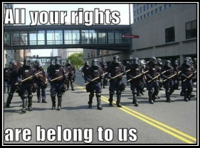

Slide 10
Oppression
The exercise of authority or power in a cruel or unjust manner.

Slide 12
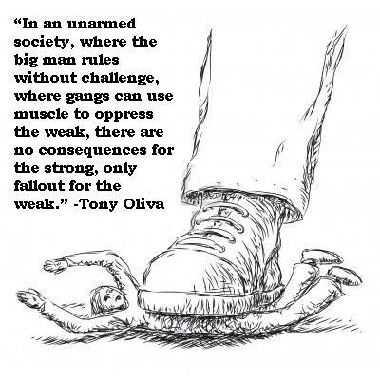
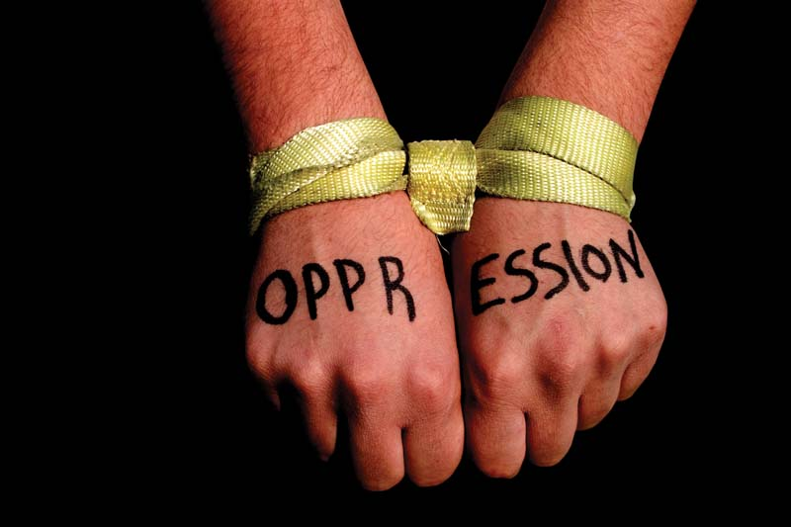

Slide 13
Massacre
A violent killing of a large number of humans

Slide 14
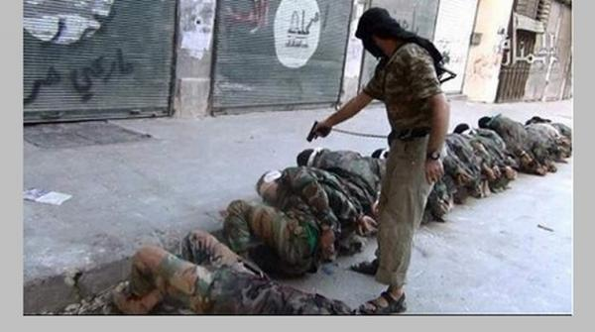
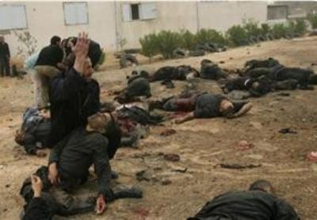

Slide 15
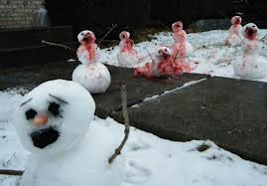

Slide 16
Political Prisoner
Someone who is put in jail or sentenced to death for his or her participation in political activities.

Slide 17
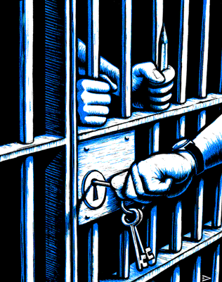
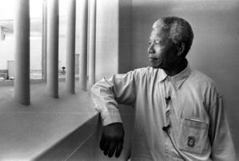

Slide 18
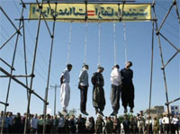
Political prisoners are often put to death for their revolutionary activities.

Slide 19
Refugee
A person who flees to a different country to escape times of war, political oppression, or even natural disasters such as hurricanes or tsunamis. This term is most often applied to those fleeing war.
****The neighboring countries of war torn areas often set up refugee camps for those forced to leave for their safety

Slide 20
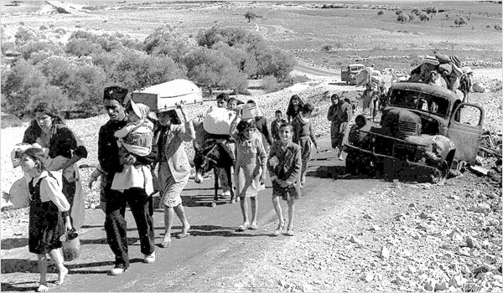

Slide 21
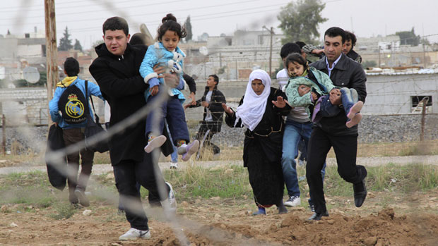
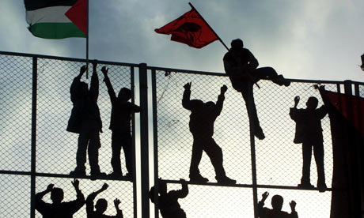

Slide 22
Martyr
A person who has laid down their life fulfilling a religious commandment , or has died fighting for their faith, family, or country.
Note: Another word for Islamic Martyr is Shahid or Shaheed, which is an Arabic meaning “witness”.

Slide 23
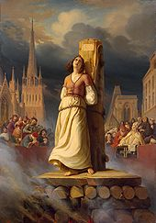
Joan of Arc was burned at the stake because of her religious and political beliefs.

Slide 24
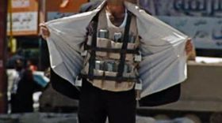
Many suicide bombers believe they are martyring themselves for their faith.

Slide 25
Civilian
A person who is not an active member of the military or police or firefighting force. Normal people who live normal lives.

Slide 26
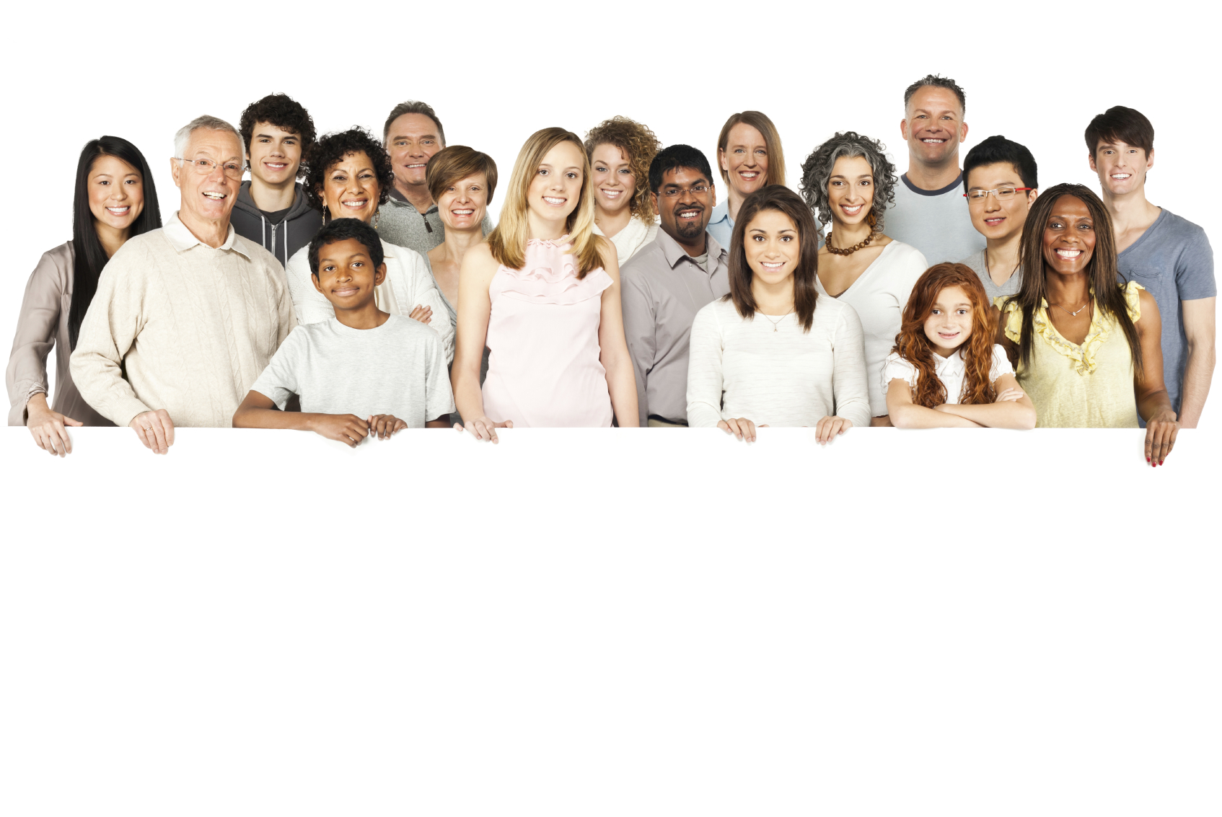

Slide 27
Rebel
A person who refuses to follow rules from the government or ruler of higher power.

Slide 28
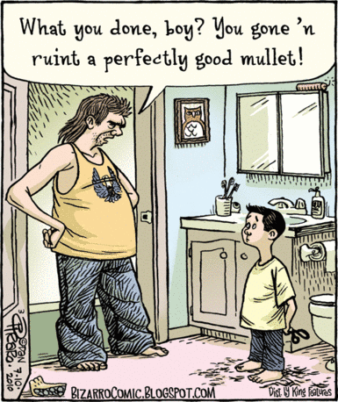
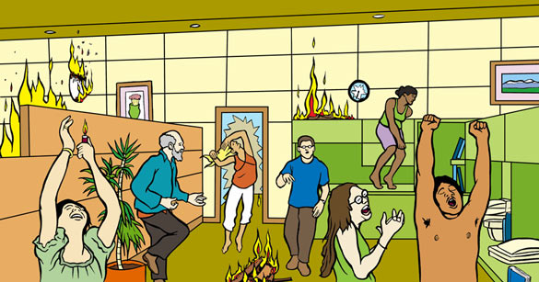

Slide 29
Victim
A person harmed, injured, or killed as a result of a crime or accident.

Slide 30
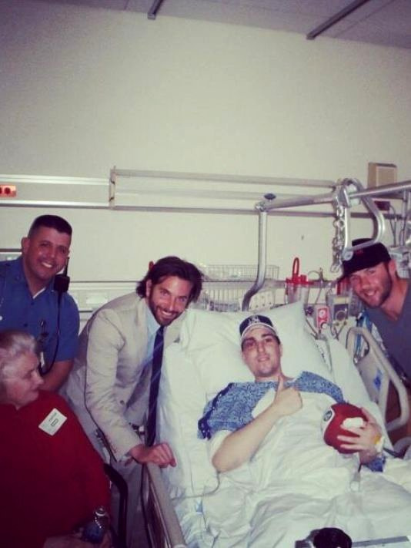
Bradley Cooper visiting VICTIM of the Boston Marathon bombing.

Slide 31
VICTIM of kidnapping.

Slide 32
Bystander
A person who is present at an event or incident but does not participate.

Slide 33
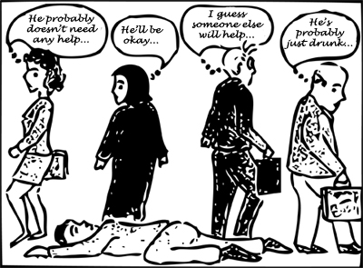
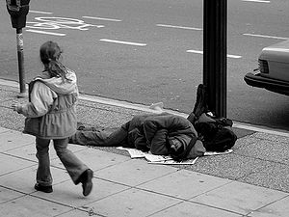

Slide 34
Displaced
When a person is driven or forced to leave his or her home but remains within the boarders of their own country.
Many people from new Orleans became displaced after hurricane Katrina.

Slide 35
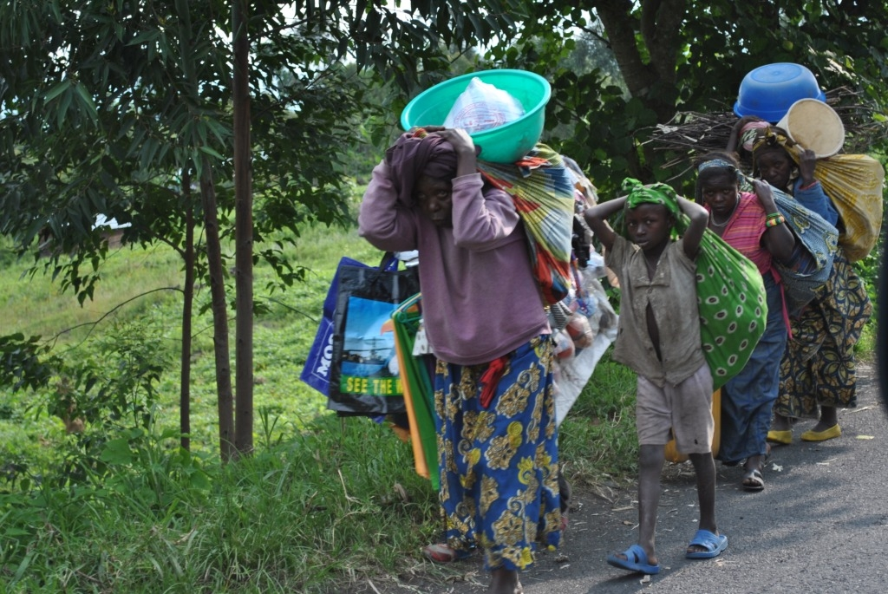

Slide 36
Militant
Showing a willingness to use strong, extreme, and sometimes forceful methods to achieve something.

Slide 37
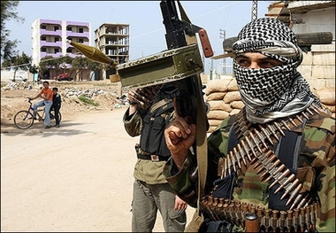

Slide 38
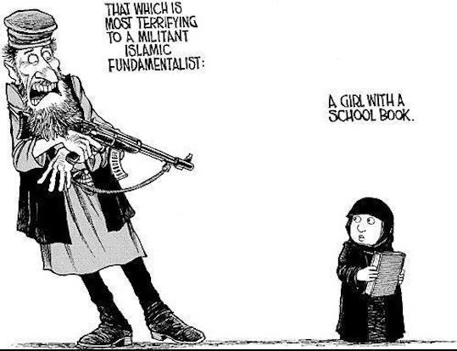

Slide 39
War is not always the choice of the people.

Slide 40
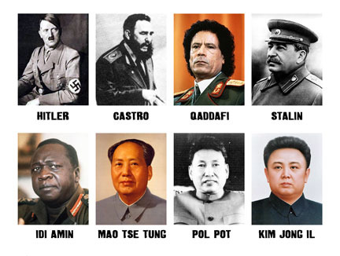
Some leaders take their countries to war while the people wish for peace.

Slide 41
