Slide 1
The English holy grail
Your grail should be complete by Thursday.
You have a written assessment Friday if your grail is complete you will be allowed to use it.

Slide 2
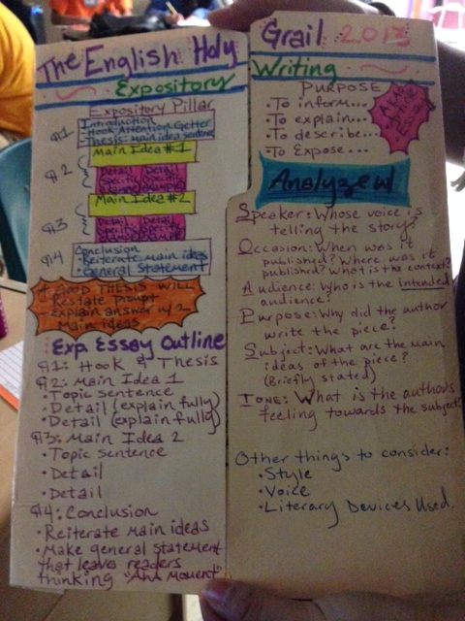
Front of Holy Grail

Slide 3
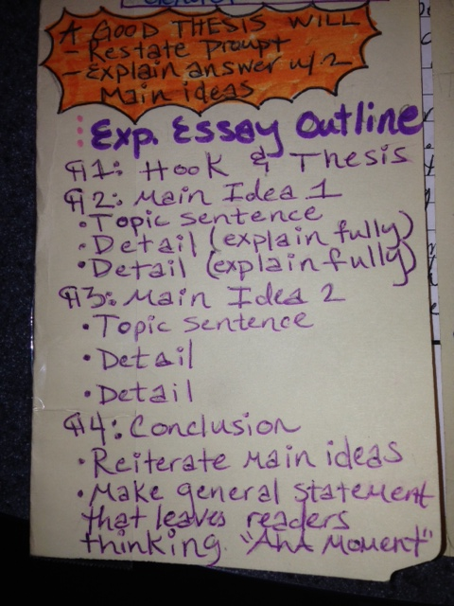
Front bottom left

Slide 4
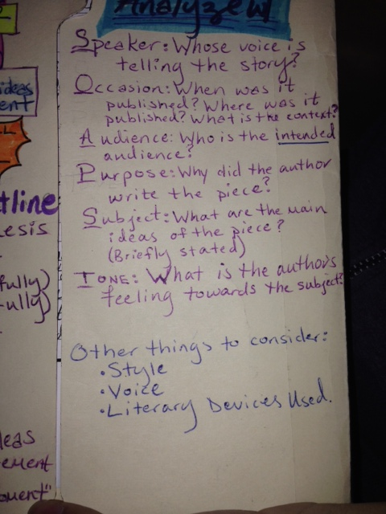
Front bottom right

Slide 5
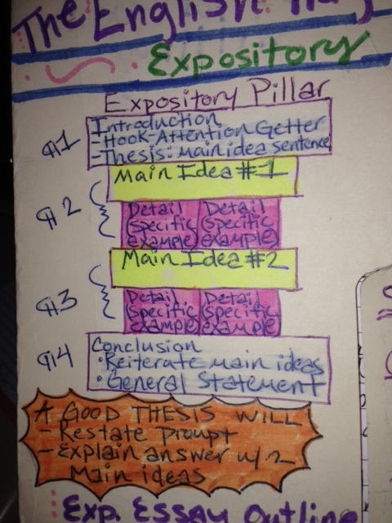
Front top left

Slide 6
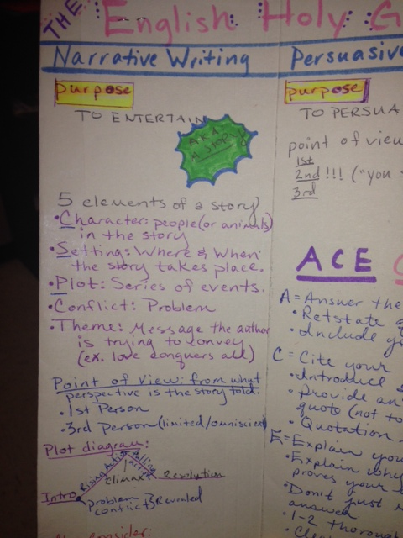
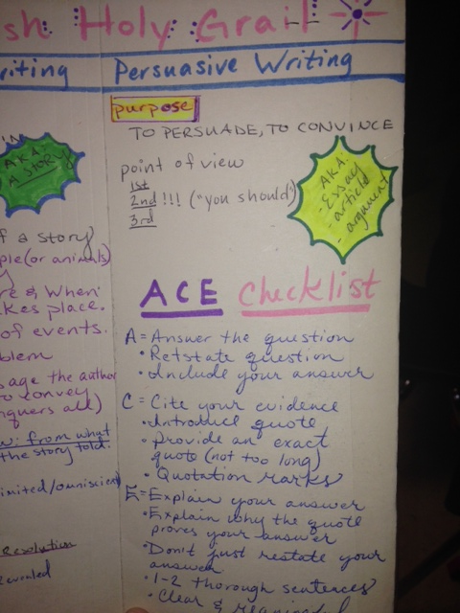

Slide 7
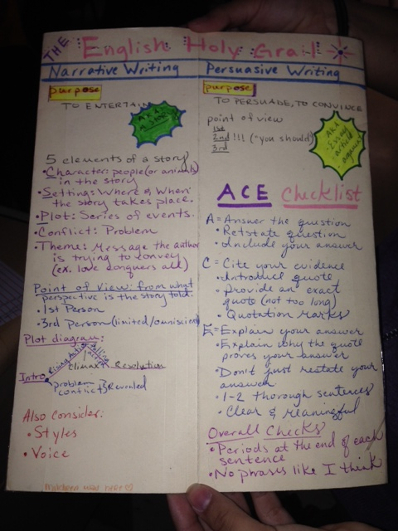
Back of the Holy Grail.

Slide 8
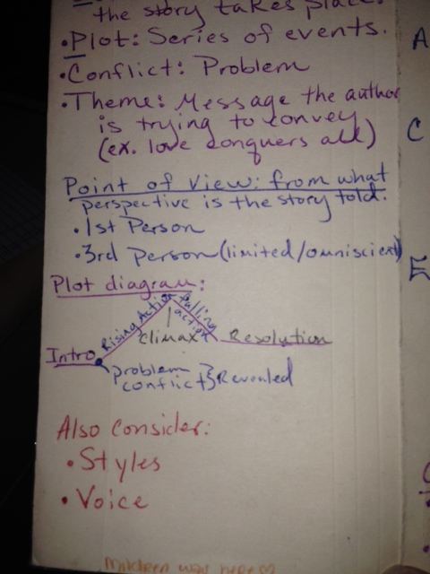
Back bottom left

Slide 9
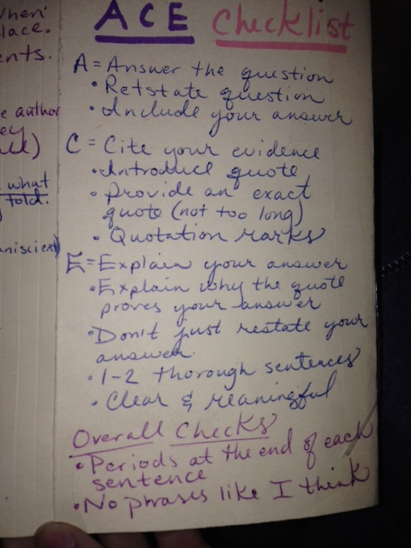
Back bottom right (Underneath the persuasive purpose section)

