Slide 1
THIS WEEK….
“You only fail if you give up”

Slide 2
SSR Logs
Due Now or Tomorrow
You should have 2 or 3
(depending on the class period)

Slide 3
OUR WEEK
MONDAY | TUESDAY | WEDNESDAY | THURSDAY | FRIDAY
Journal SSR Tone Workshop | Journal Plan an Essay SOAPSTone an Article | Journal Plan an Essay SOAPSTone an Article | TEST: Write an Expository Essay | TEST: Read and Analyze
DUE: SSR Log DUE: Tone Exit Ticket | DUE: Expository Essay Final Draft | DUE: Journal Check | DUE: (2) SOAPSTone & ACE

Slide 4
WHAT IS ON THE TEST?
REVIEW SHEETS
THURSDAY:
1 Expository Essay (Plan and Write)
FRIDAY:
15 Multiple Choice
3 Quick Answer
2 ACE

Slide 5
TUTORIALS THIS WEEK
NO Makeup work after school
Have zeros that need to be corrected? Come during lunch.
MONDAY AFTER SCHOOL: Expository Essay & ACE
TUESDAY AFTER SCHOOL: Expository Writing, ACE, SOAPSTone

Slide 6
SHOW YOUR ATTITUDE WITH TONE
TONE….Tone…TONE….Tone…TONE….Tone…TONE….Tone…TONE….Tone…TONE….Tone…

Slide 7
WHAT IS TONE?

Slide 8
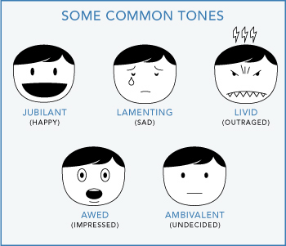
TONE WORDS

Slide 9
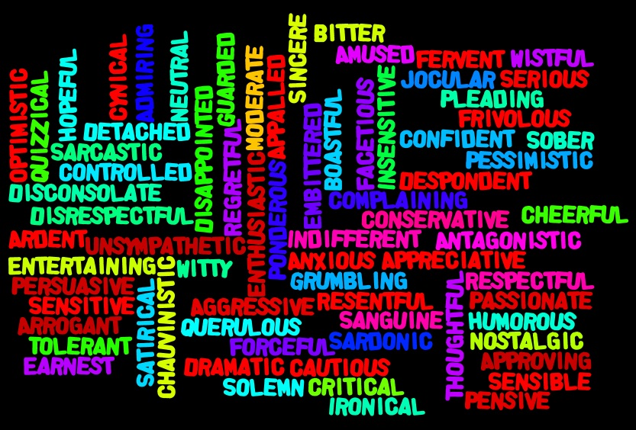
TONE WORDS

Slide 10
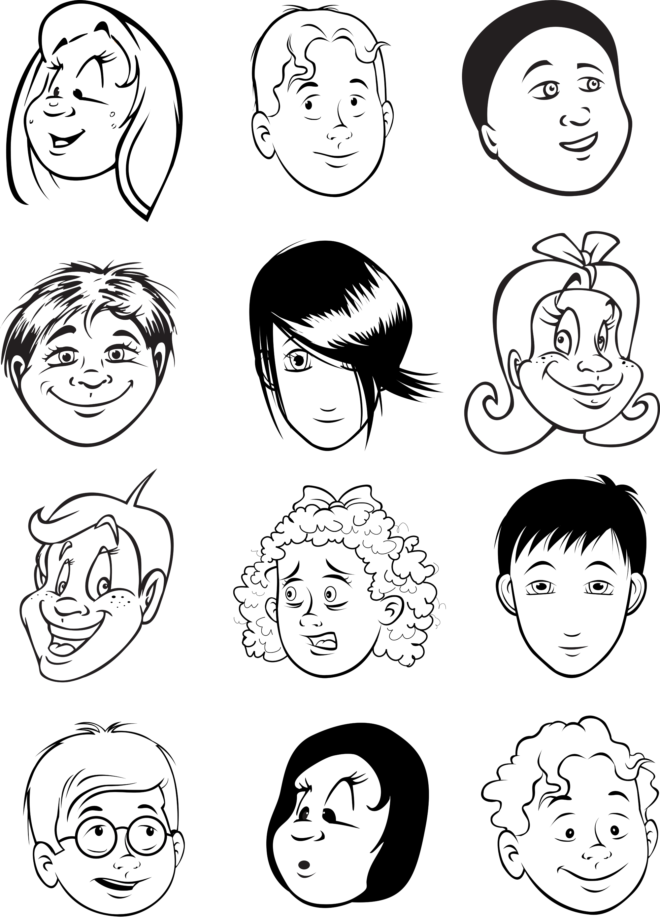
What might be their Tone?

Slide 11
TONE SNOWBALL
On a sheet of paper:
Write a Sentence
A Tone It Should Be Said In
EXAMPLE
“That shirt is my favorite.”
Tone: ANGRY
Tone words:
Afraid Angry Apologetic Benevolent Bitter Boring | Candid Celebratory Childish Cold Complimentary Defensive | Didactic Dramatic Dreamy Encouraging Happy Horrified | Humorous Inspiring Joking Joyful Mocking Nostalgic | Objective Peaceful Pitiful Proud Sad Sarcastic | Seductive Sentimental Shocking Silly Somber Sweet | Sympathetic Tired Upset Urgent Vexed Vibrant

Slide 12
1 PHRASE, 3 WAYS
Phrase: “Good Morning”
Tones: happy
sarcastic
somber
Afraid Angry Apologetic Benevolent Bitter Boring | Candid Celebratory Childish Cold Complimentary Defensive | Didactic Dramatic Dreamy Encouraging Happy Horrified | Humorous Inspiring Joking Joyful Mocking Nostalgic | Objective Peaceful Pitiful Proud Sad Sarcastic | Seductive Sentimental Shocking Silly Somber Sweet | Sympathetic Tired Upset Urgent Vexed Vibrant

Slide 13
1 PHRASE, 3 WAYS
Phrase: “I am passing my English class!”
Tones: proud
celebratory
relieved
Afraid Angry Apologetic Benevolent Bitter Boring | Candid Celebratory Childish Cold Complimentary Defensive | Didactic Dramatic Dreamy Encouraging Happy Horrified | Humorous Inspiring Joking Joyful Mocking Nostalgic | Objective Peaceful Pitiful Proud Sad Sarcastic | Seductive Sentimental Shocking Silly Somber Sweet | Sympathetic Tired Upset Urgent Vexed Vibrant

Slide 14
1 PHRASE, 3 WAYS
Phrase: “You have a crush on Johnny.”
Tones: joking
dramatic
sweet
Afraid Angry Apologetic Benevolent Bitter Boring | Candid Celebratory Childish Cold Complimentary Defensive | Didactic Dramatic Dreamy Encouraging Happy Horrified | Humorous Inspiring Joking Joyful Mocking Nostalgic | Objective Peaceful Pitiful Proud Sad Sarcastic | Seductive Sentimental Shocking Silly Somber Sweet | Sympathetic Tired Upset Urgent Vexed Vibrant

Slide 15
TONE TEXT

Slide 16
SHOW IT WITH TONE EXIT TICKET
Choose one of the tone words below.
Write the tone word. Then, write a 5 sentence paragraph using that tone!
Didactic
Somber
Afraid
Angry
Celebratory
Vexed
Nostalgic
Proud

