Slide 1
Writing Assessment
November 22, 2013
IWBAT Demonstrate my knowledge of the three styles of writing by completing the writing assessment.
Remember to slow down and truly analyze the photos.

Slide 2
What can you infer about the setting of the photo? You must use ACE to answer the question. Your evidence is a specific detail from the photo.

Slide 3
What can you infer about on of the individuals in the photo? You must use ACE to answer the question. Your evidence is a specific detail from the photo.

Slide 4
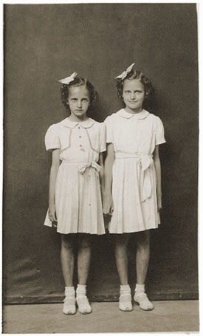
What can you infer about the individual in the photo? You must use ACE to answer the question. Your evidence is a specific detail from the photo.
If you need to get closer to the photo you may; but do so without speaking.

Slide 5
Plan and draft an essay for the prompt below. Be sure to assess what type of essay is appropriate before you begin.
Write an essay explaining the importance of being honest.

